Slide 1
Assembly
Introduction to Core subjects of Maths, Science and English.
Why are these important?
What areas do you need to focus on over the rest of this year?

Slide 2
Post-16 Education
Apprenticeships
Post-18 Education
Results Day – August 2023
Revision Sessions
Targeted Intervention
Spring 2023 Mocks
Closing the Gap
Autumn 2022 Mocks
Intervention
Grab-a-Grade
EOY10 Mock Exams

Slide 3
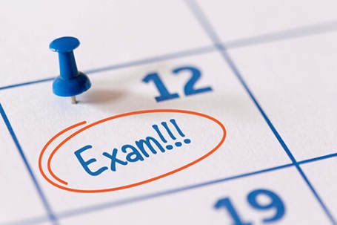
English Literature and Language Exams
Chase the marks!

Slide 4
English Department
Understanding The Course
Section A – Responding to Shakespeare
Section B – Responding to 19th Century Novel
1hr 45mins = 40% GCSE
Section A – responding to fiction text
Section B – writing descriptively or narratively
1hr 45mins = 50% GCSE
Literature Paper 1
Language Paper 1
Literature Paper 2
Language Paper 2
Section A – responding to non-fiction texts
Section B – writing a viewpoint
1hr 45mins = 50% GCSE
Section A – Responding to Modern Text
Section B – Responding to pre-studied poetry
Section C – Responding to unseen poetry
2hr 15mins = 60% GCSE

Slide 5
English Department
Understanding The Exam: Language
English Language Paper 2:
Reading: 2 Non- Fiction Extracts 4 questions.
-True or False
-Summary of both texts.
-Language
-Comparison.
Writing: Argue, persuade, advise.
English Language Paper 1:
Reading: 1 Fictional Extract 4 questions
-Identify 4 quotes
-Language
-Structure
-Evaluation
Writing: Description or narrative in response to an image.

Slide 6
English Department
Understanding The New
English Literature Paper 1:
Victorian Fiction: One question on your Victorian text (character or theme) writing about an extract AND the rest of the text
Modern Fiction: One question on An Inspector Calls – no extract.
English Literature Paper 2:
Shakespeare: One question on character or theme writing about an extract AND the rest of the text.
Unseen poetry: Two questions: -Analysis of an unseen poem.
-Comparison of two unseen poems.
https://www.aqa.org.uk/subjects/english/gcse/english-literature-8702/assessment-resources

Slide 7
Monitoring your progress
In class mock styled assessments.
Mock exams:
Language Paper 1 and Literature Paper 1 Term 2
Language Paper 2 and Literature Paper 2 Term 3.
Blind- Teach- timed skills tests.
Homework

Slide 8
How the English team can support you
Revision/ exam lessons.
Writing frameworks, scaffolds and sentence starters.
Modelled responses.
Dual coding.
Homework.
Sessions after school on a Tuesday and a Thursday.
Books are available to purchase on Wisepay, including revision guides.

Slide 9
Useful Websites
-Massolit
-GCSE pod -Oak National -Seneca
-BBC Bitesize
-Sparknotes
-Shmoop
-Yorknotes
-Cliffnotes
-Revision World
-Youtube- Mr Bruff- Stacey Reay
https://www.youtube.com/watch?v=dABvuspS9Vo
https://www.youtube.com/watch?v=qUZwAZHf8kY

Slide 10
I had to put the work in every single day
When I got home I would think about all the things that I had been taught during the day to consolidate my knowledge.
For the most part these results are down to working hard in all lessons.
I revised practically every night so it was about doing consistent hard work. I would advise students to work hard because consistency is the key to this, mainly focusing in lessons and making the most of your time, asking the teacher for help if you need it and just concentrating.
‘I did two hours of revision a night in Year 11 so that by the time exams came around I didn’t have to worry as much. I stayed behind a lot after school and the teachers were really helpful. I would advise students to push themselves to work as hard as they can.
Notes:
Comments from past students about how they achieved exam success.

Slide 11
3 reasons why English is important
You need a Grade 4 otherwise you will need to resit and it may limit your further education.
“Opens doors”- enables you to have more choices (access to a range of subjects, courses, schools, colleges, apprenticeships, etc).
Provides you with crucial communication and literacy skills required for all areas of life regardless of what you go on to do.

Slide 12
Maths Exams
Chase the marks!

Slide 14
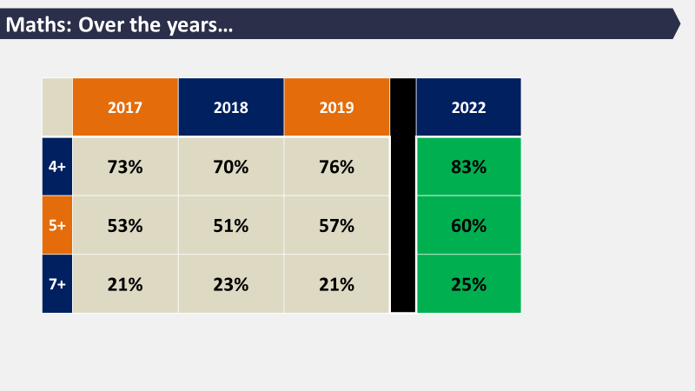

Slide 19
Science Exams
Chase the marks!

