Slide 1
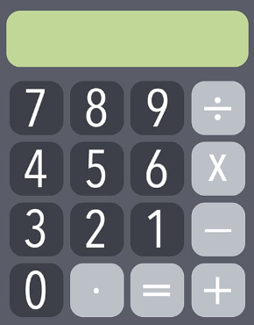

Year 11 – Paper 1 Revision Pack (Higher)
Please attempt all questions without a calculator.
The only sheet you may need a calculator for is the density section. (These have been included because they demonstrate the range of style of questions you could be asked in the exam.)
Friday 20th May 2021 - AM

Slide 2
How to use this revision pack
Review the list of topics that will appear on paper 1 of the summer exams. This can be found on the next page.
Work through the revision pages for each of the topics that will appear on the summer exams.
Use the electronic mark scheme to check your work and identify areas of weakness. The electronic mark scheme can be found on Teams and Satchel One.
Follow up with either:
  Using the Hegarty Maths Clip Numbers to watch video tutorials on areas of weakness. You should then complete the quizzes on Hegarty to test whether you have closed your gap in knowledge.
  OR
  B. Follow the link for Maths Genie Exam Practice and search for the pack of questions relating to each topic (Mark Schemes Provided)
  Each of these options is clearly labelled at the bottom of each page of revision.
You can also access whole past papers at https://corbettmaths.com/2022/02/28/edexcel-gcse-higher-summer-2022/ You should select Advanced Information – Paper 1 (Set A and Set B)
Email your class teacher if you have any questions or require further resources. Email Mr Lee if you need help during the school holidays.

Slide 3
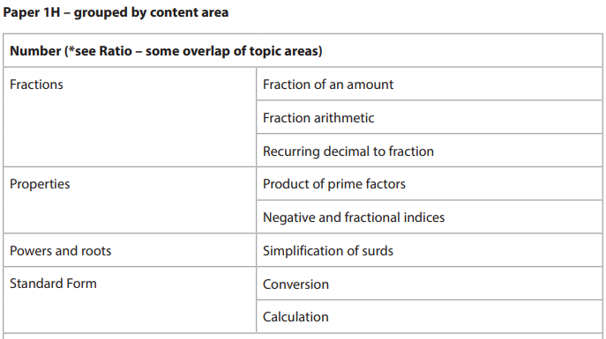
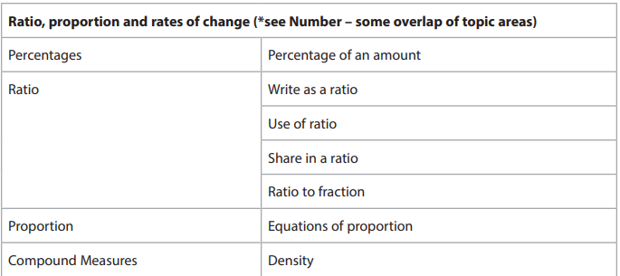
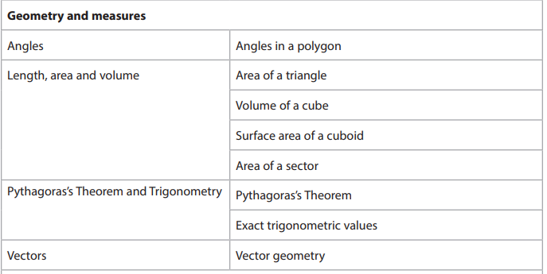
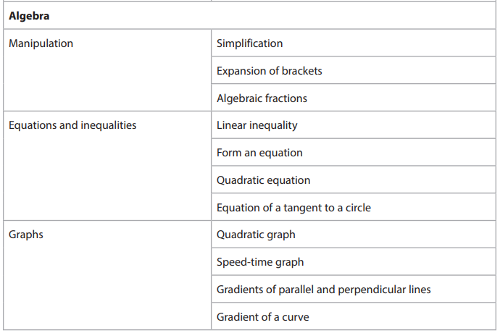
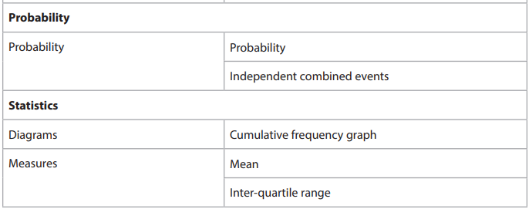
Advanced Information – 1H
Non-Calculator

Slide 4
Section A: Number

Slide 5

Fraction of an amount
Find 3/4 of 28. | Increase 28 by 3/4
3/4 of x is 33. Find x. | 3/4 of x is 12. Find 5/4 of x.
FOLLOW-UP WORK
Clip 77
https://www.mathsgenie.co.uk/gcse-may-june-2022-higher-topics.html
Fractions of an Amount

Slide 6
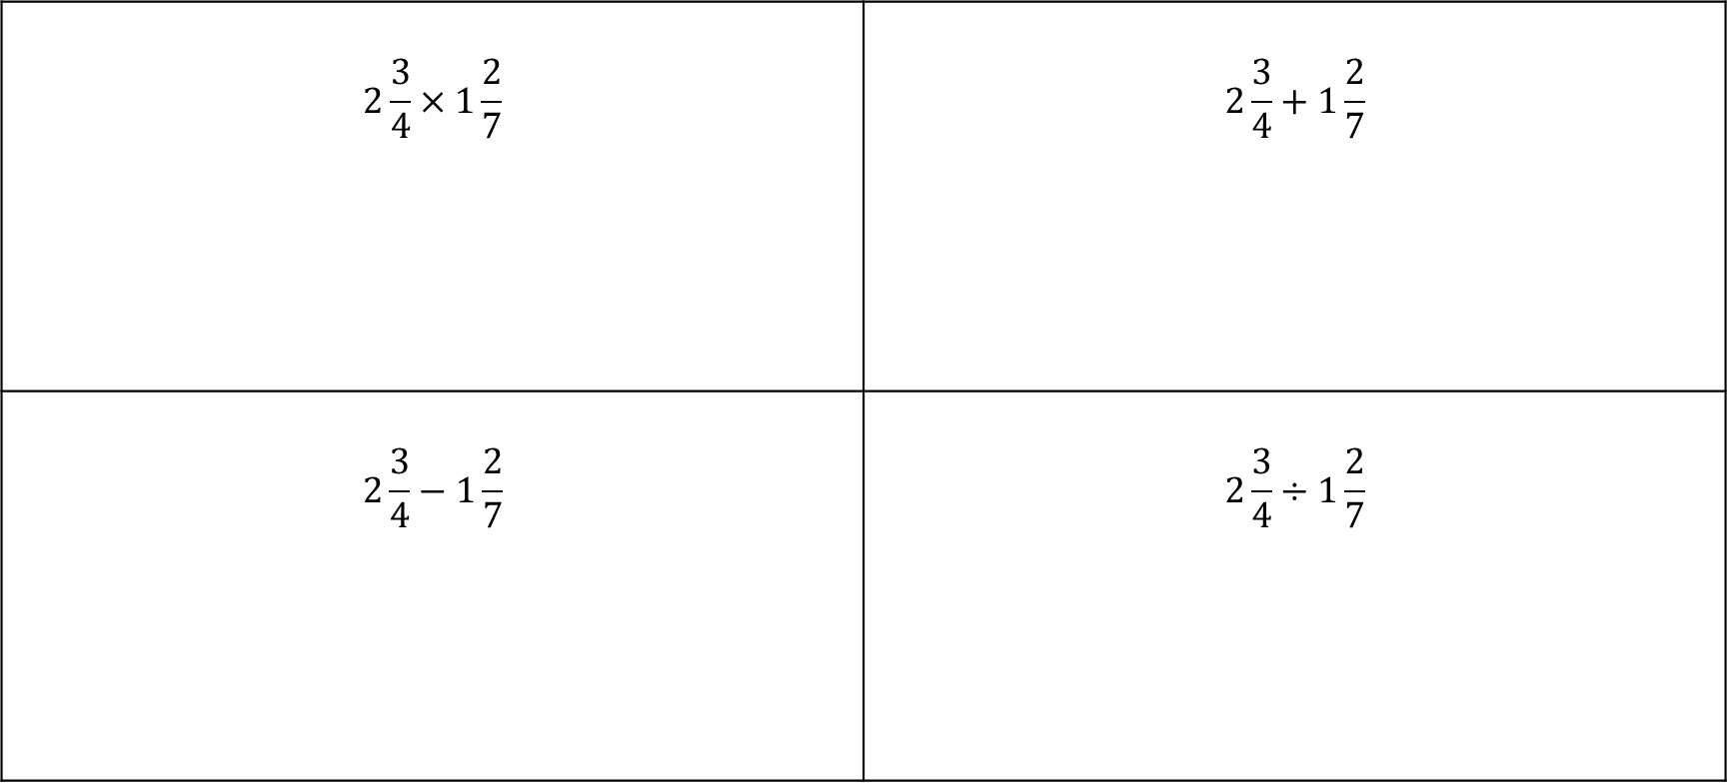
Fraction Arithmetic
$$2\frac{3}{4}×1\frac{2}{7}$$ | $$2\frac{3}{4}+1\frac{2}{7}$$
$$2\frac{3}{4}−1\frac{2}{7}$$ | $$2\frac{3}{4}÷1\frac{2}{7}$$
FOLLOW-UP WORK
Clips
65-70,80
https://www.mathsgenie.co.uk/gcse-may-june-2022-higher-topics.html
Fractions

Slide 7
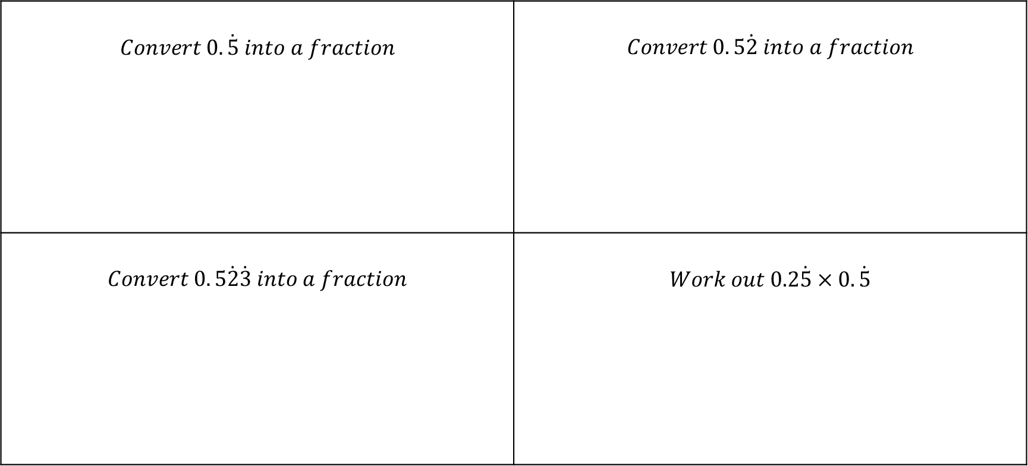
Recurring Decimals to Fractions
$$Convert 0.\dot{5} into a fraction$$ | $$Convert 0. 5\dot{2} into a fraction$$
$$Convert 0. 5\dot{2}\dot{3} into a fraction$$ | $$Work out 0.2\dot{5}×0.\dot{5}$$
FOLLOW-UP WORK
Clip 53,54
https://www.mathsgenie.co.uk/gcse-may-june-2022-higher-topics.html
Recurring Decimals to Fractions

Slide 8
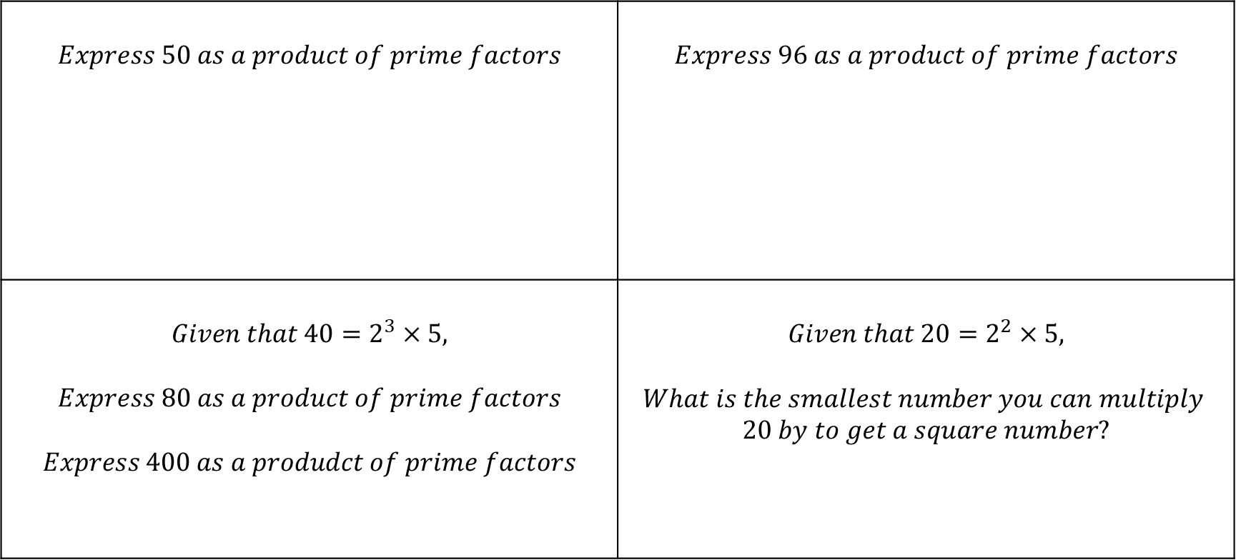
Product of prime factors
$$Express 50 as a product of prime factors$$ | $$Express 96 as a product of prime factors$$
$$Given that 40=2^{3}×5,$$ $$Express 80 as a product of prime factors$$ $$Express 400 as a produdct of prime factors$$ | $$Given that 20=2^{2}×5,$$ $$What is the smallest number you can multiply \\ 20 by to get a square number?$$
FOLLOW-UP WORK
Clip 29,30,32,35
https://www.mathsgenie.co.uk/gcse-may-june-2022-higher-topics.html
Prime Factors, HCF & LCM

Slide 9
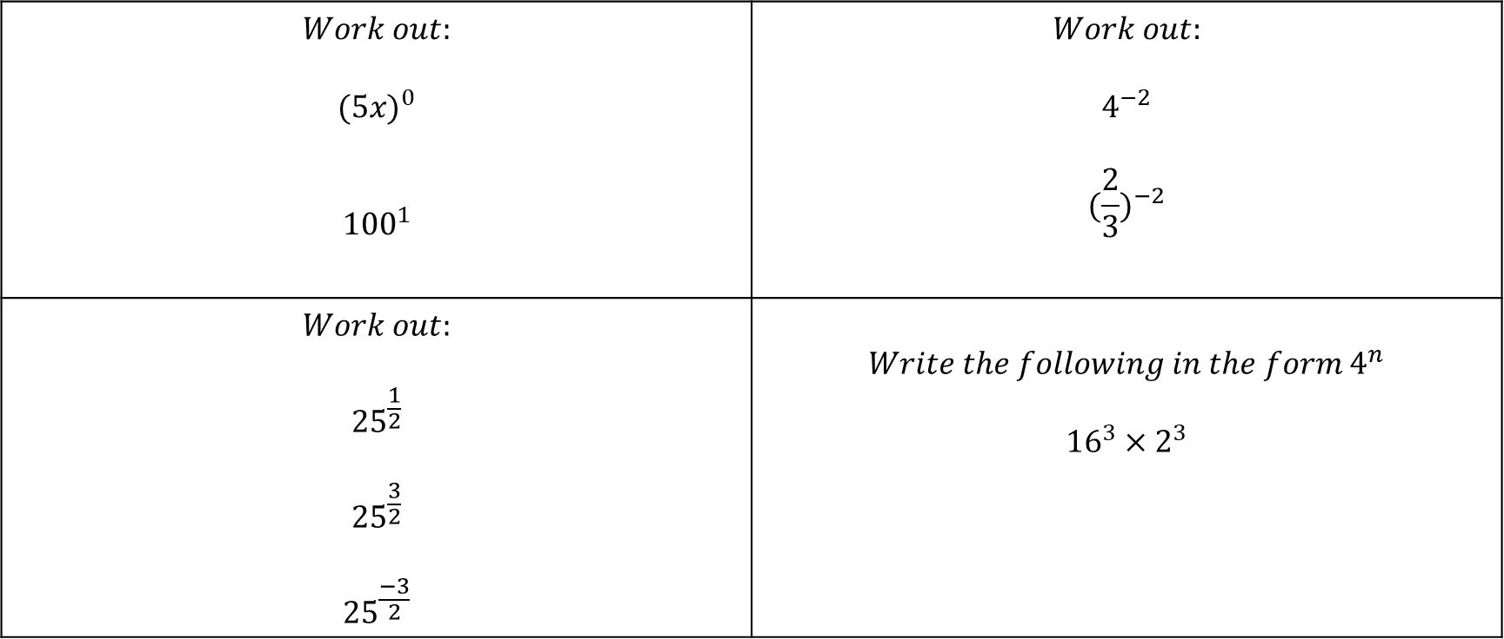
Indices
$$Work out:$$ $${(5x)}^{0}$$ $${100}^{1}$$ | $$Work out:$$ $$4^{−2}$$ $${(\frac{2}{3})}^{−2}$$
$$Work out:$$ $${25}^{\frac{1}{2}}$$ $${25}^{\frac{3}{2}}$$ $${25}^{\frac{−3}{2}}$$ | $$Write the following in the form 4^{n}$$ $${16}^{3}×2^{3}$$
FOLLOW-UP WORK
Clip 104-110
https://www.mathsgenie.co.uk/gcse-may-june-2022-higher-topics.html
Fractional & Negative Indices

Slide 10
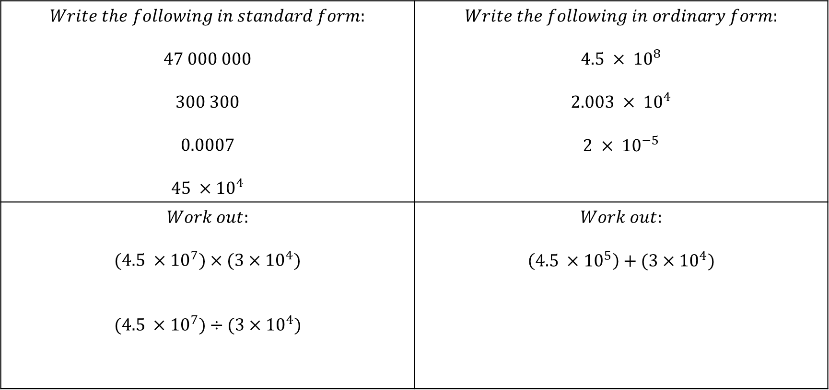
Standard Form
$$Write the following in standard form:$$ $$47 000 000$$ $$300 300$$ $$0.0007$$ $$45 ×{10}^{4}$$ | $$Write the following in ordinary form:$$ $$4.5 × {10}^{8}$$ $$2.003 × {10}^{4}$$ $$2 × {10}^{−5}$$
$$Work out:$$ $$(4.5 ×{10}^{7})×(3×{10}^{4})$$ $$(4.5 ×{10}^{7})÷(3×{10}^{4})$$ | $$Work out:$$ $$\left(4.5 ×{10}^{5}\right)+(3×{10}^{4})$$
FOLLOW-UP WORK
Clip 122-127
https://www.mathsgenie.co.uk/gcse-may-june-2022-higher-topics.html
Standard Form

Slide 11
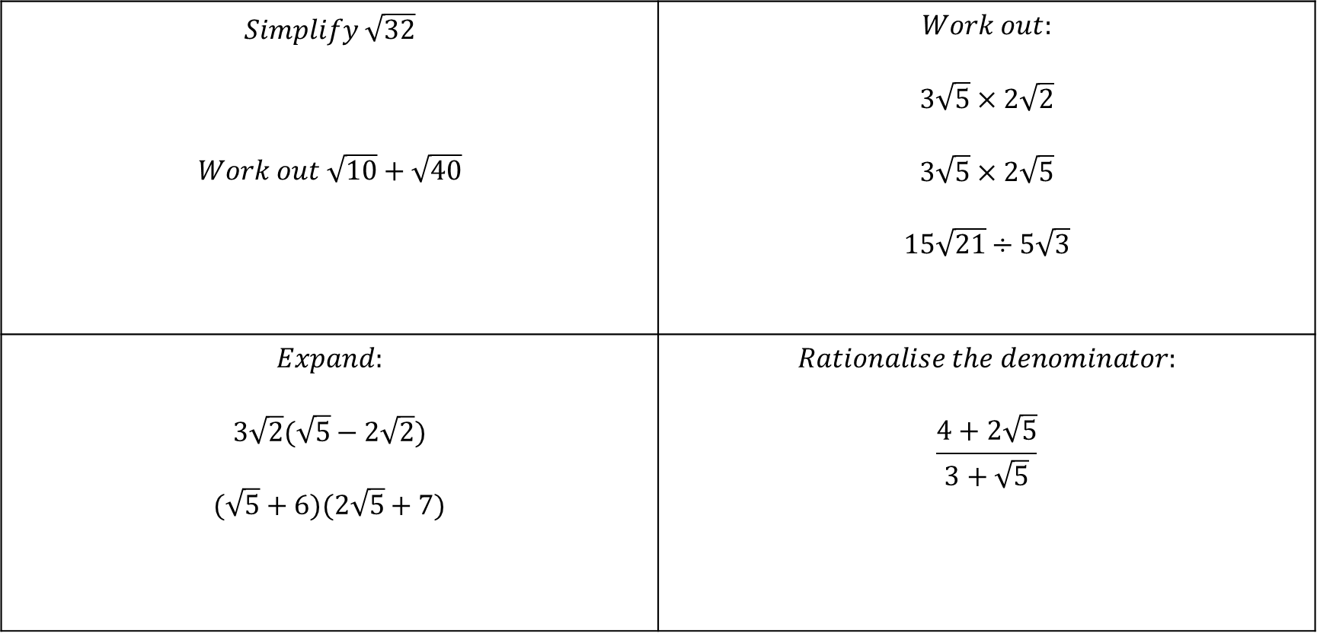
Surds
$$Simplify \sqrt{32}$$ $$Work out \sqrt{10}+\sqrt{40}$$ | $$Work out:$$ $$3\sqrt{5}×2\sqrt{2}$$ $$3\sqrt{5}×2\sqrt{5}$$ $$15\sqrt{21}÷5\sqrt{3}$$
$$Expand:$$ $$3\sqrt{2}(\sqrt{5}−2\sqrt{2})$$ $$(\sqrt{5}+6)(2\sqrt{5}+7)$$ | $$Rationalise the denominator:$$ $$\frac{4+2\sqrt{5}}{3+\sqrt{5}}$$
FOLLOW-UP WORK
Clip 113-119
https://www.mathsgenie.co.uk/gcse-may-june-2022-higher-topics.html
Surds

Slide 12
Section B: Algebra

Slide 13
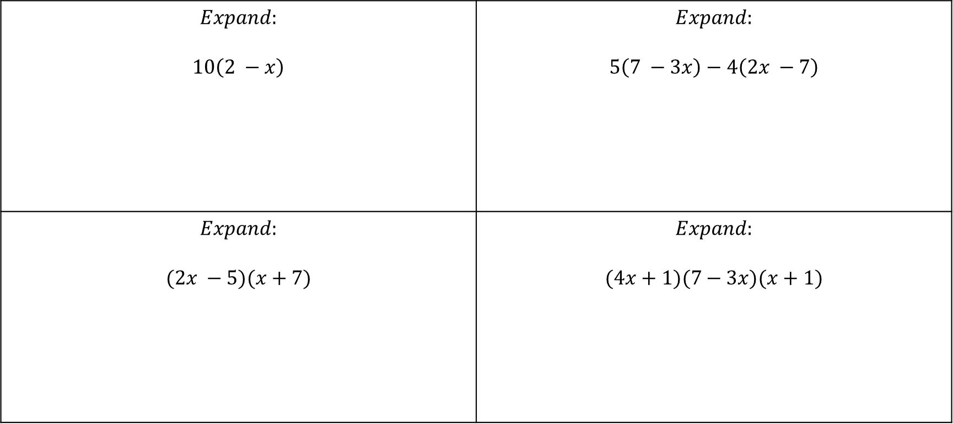
Expansion of Brackets
$$Expand:$$ $$10\left(2 −x\right)$$ | $$Expand:$$ $$5\left(7 −3x\right)−4\left(2x −7\right)$$
$$Expand:$$ $$(2x −5)(x+7)$$ | $$Expand:$$ $$(4x+1)(7−3x)(x+1)$$
FOLLOW-UP WORK
Clips 160-166
https://www.mathsgenie.co.uk/gcse-may-june-2022-higher-topics.html
Expanding and Factorising Brackets and Expanding and Factorising Quadratics

Slide 14
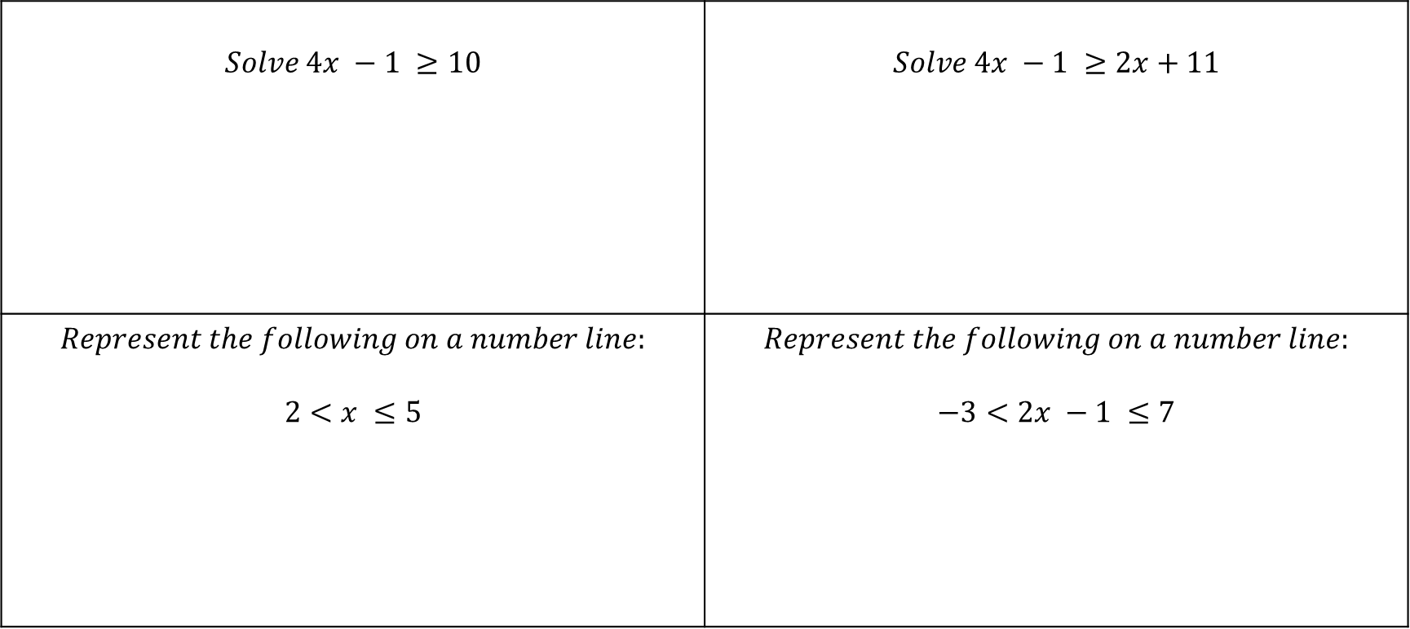
Inequalities
$$Solve 4x −1 ≥10$$ | $$Solve 4x −1 ≥2x+11$$
$$Represent the following on a number line:$$ $$2<x ≤5$$ | $$Represent the following on a number line:$$ $$−3<2x −1 ≤7$$
FOLLOW-UP WORK
Clips 265-272
https://www.mathsgenie.co.uk/gcse-may-june-2022-higher-topics.html
Inequalities

Slide 15
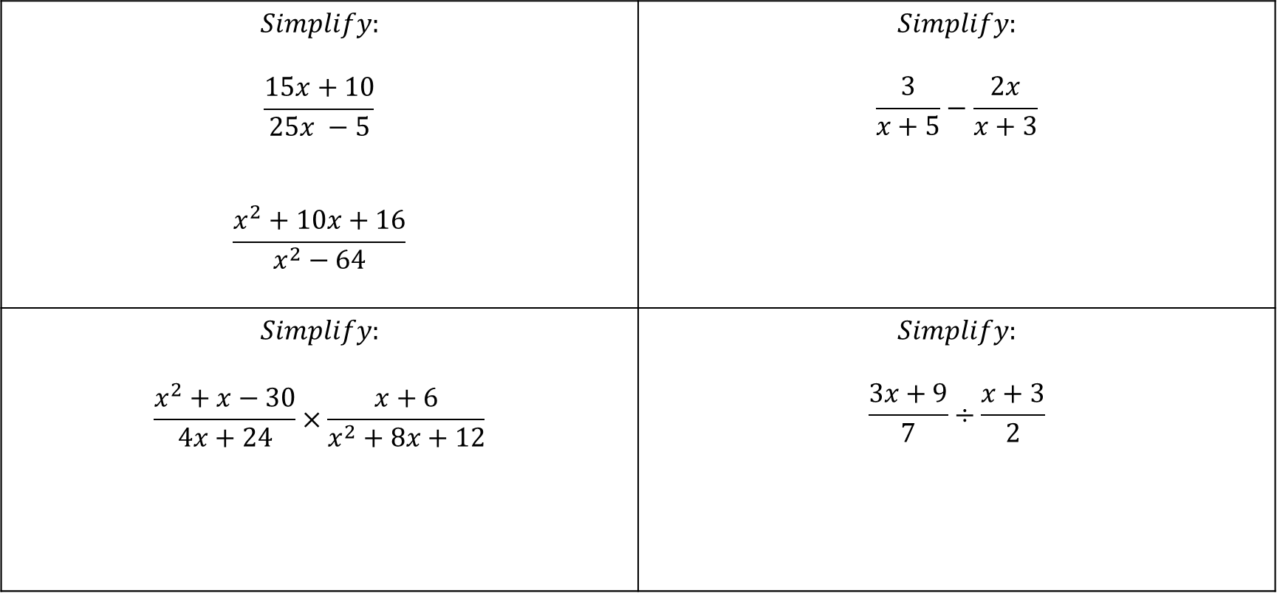
Algebraic Fractions
$$Simplify:$$ $$\frac{15x+10}{25x −5}$$ $$\frac{x^{2}+10x+16}{x^{2}−64}$$ | $$Simplify:$$ $$\frac{3}{x+5}−\frac{2x}{x+3}$$
$$Simplify:$$ $$\frac{x^{2}+x−30}{4x+24}×\frac{x+6}{x^{2}+8x+12}$$ | $$Simplify:$$ $$\frac{3x+9}{7}÷\frac{x+3}{2}$$
FOLLOW-UP WORK
Clip 159,170, 172, 229
https://www.mathsgenie.co.uk/gcse-may-june-2022-higher-topics.html
Algebraic Fractions

Slide 16
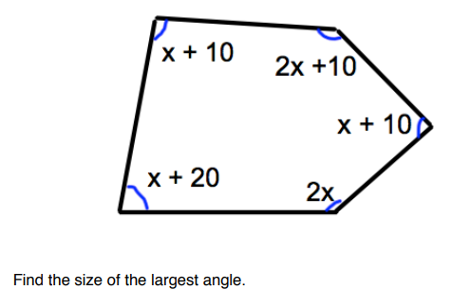
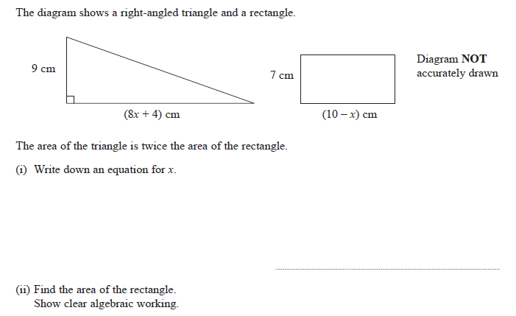
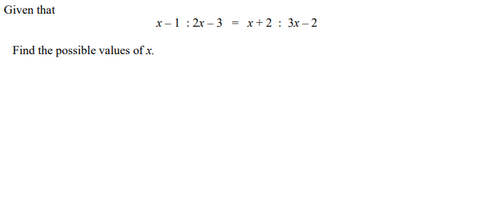
Forming Equations
FOLLOW-UP WORK
Clip 176
https://www.mathsgenie.co.uk/gcse-may-june-2022-higher-topics.html
Forming & Solving Equations

Slide 17
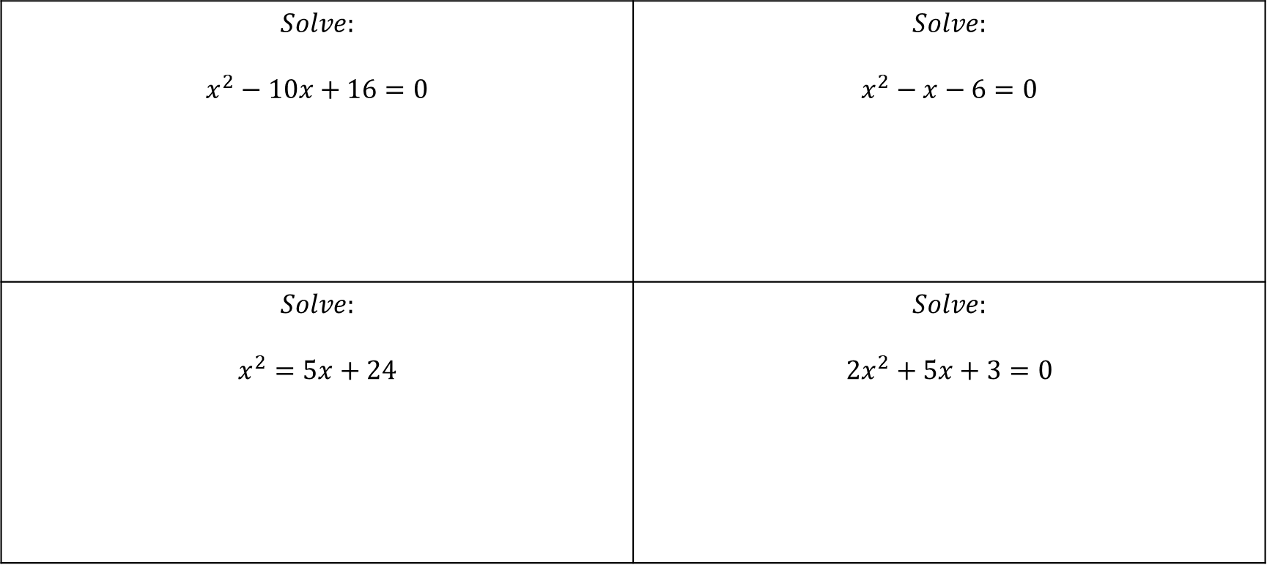
Quadratic Equations
$$Solve:$$ $$x^{2}−10x+16=0$$ | $$Solve:$$ $$x^{2}−x−6=0$$
$$Solve:$$ $$x^{2}=5x+24$$ | $$Solve:$$ $$2x^{2}+5x+3=0$$
FOLLOW-UP WORK
Clip 230-234; 238-242; 244, 245
https://www.mathsgenie.co.uk/gcse-may-june-2022-higher-topics.html
Solving Quadratics

Slide 18
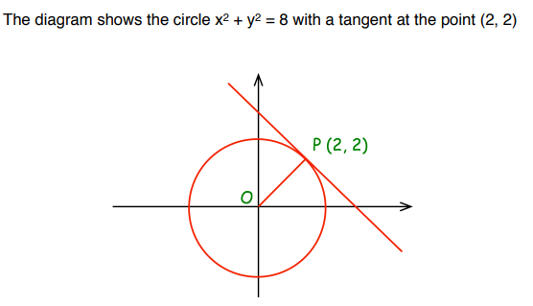
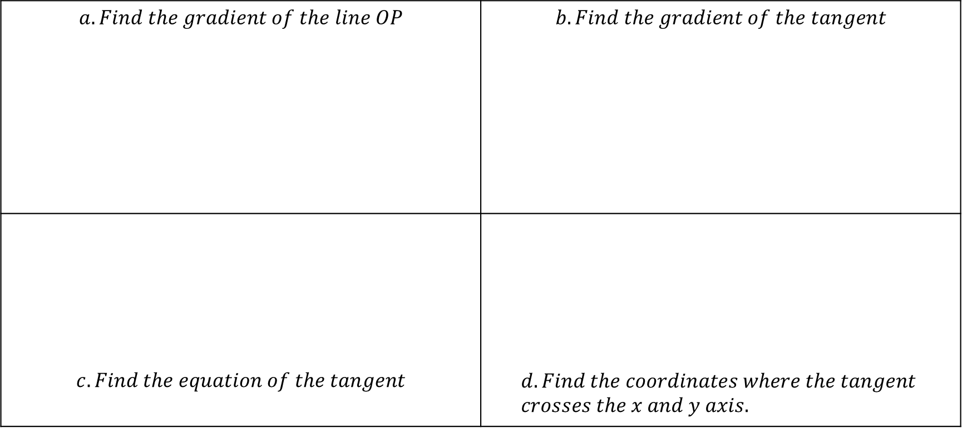
Equations of tangents to circles
$$a. Find the gradient of the line OP$$ | $$b. Find the gradient of the tangent$$
$$c. Find the equation of the tangent$$ | $$d. Find the coordinates where the tangent \\ crosses the x and y axis.$$
FOLLOW-UP WORK
Clip 320
https://www.mathsgenie.co.uk/gcse-may-june-2022-higher-topics.html
Perpendicular Lines and the equation of a tangent

Slide 19
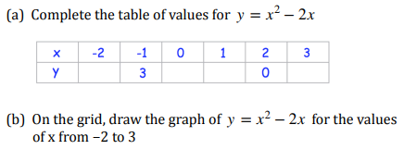
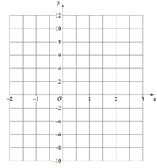
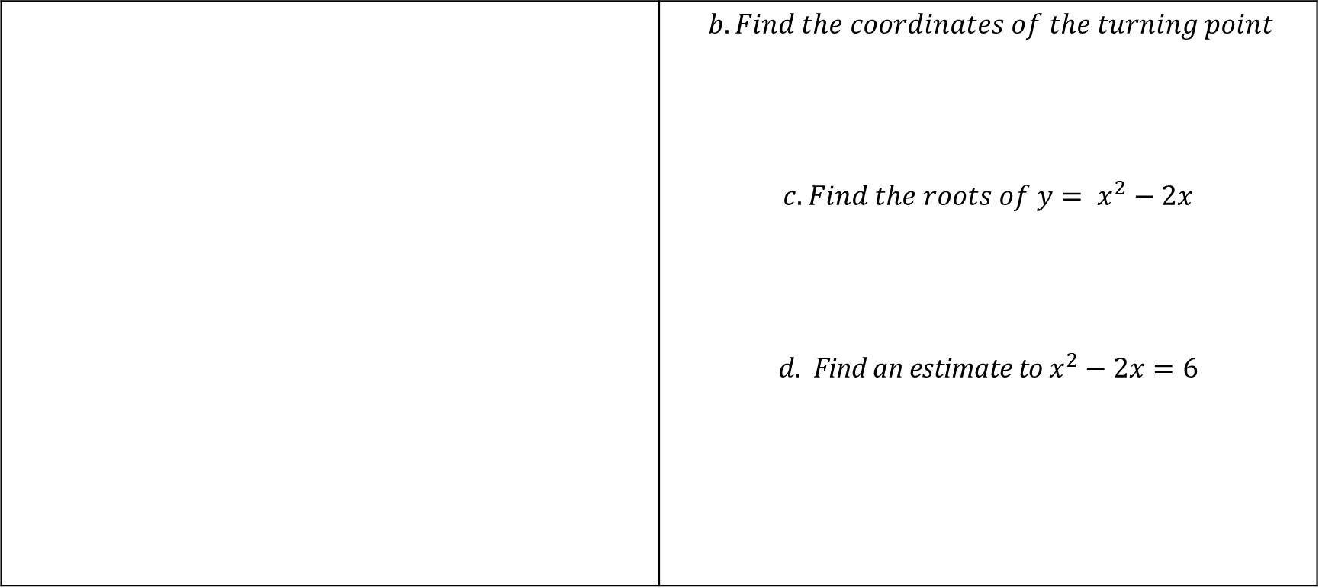
Quadratic Graphs
 | $b. Find the coordinates of the turning point$ $$c. Find the roots of y= x^{2}−2x$$ $$d. \text{Find} \text{an} \text{estimate} \text{to} x^{2}−2x=6$$
FOLLOW-UP WORK
Clip 251-257, 260
https://www.mathsgenie.co.uk/gcse-may-june-2022-higher-topics.html
Drawing Quadratic Graphs

Slide 20
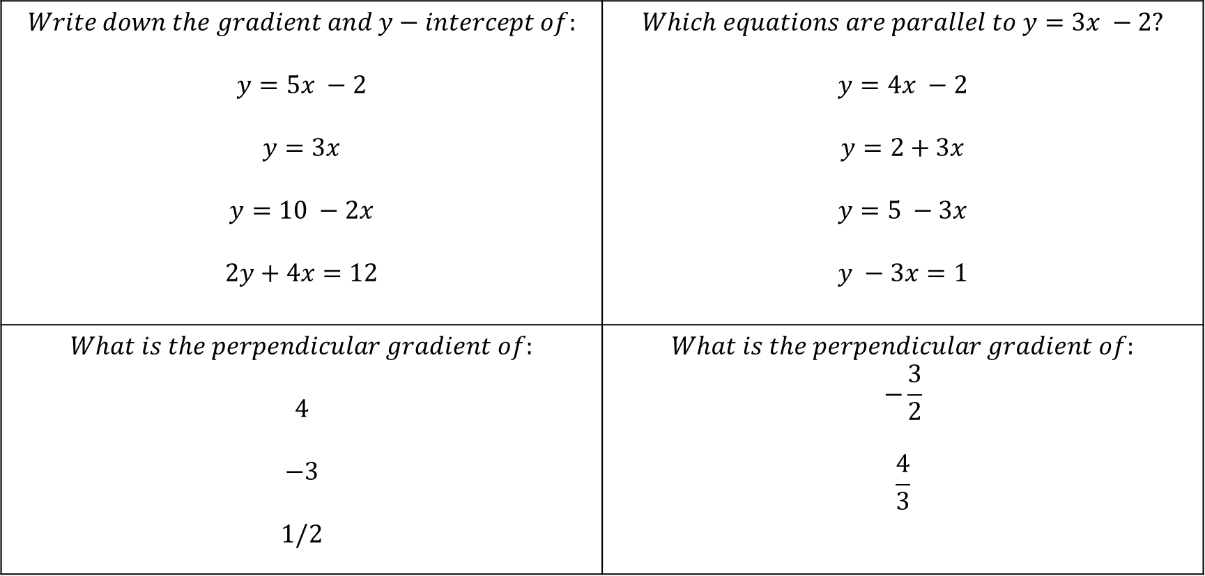
Gradients of Parallel & Perpendicular Lines
$$Write down the gradient and y−intercept of:$$ $$y=5x −2$$ $$y=3x$$ $$y=10 −2x$$ $$2y+4x=12$$ | $$Which equations are parallel to y=3x −2?$$ $$y=4x −2$$ $$y=2+3x$$ $$y=5 −3x$$ $$y −3x=1$$
$$What is the perpendicular gradient of:$$ $$4$$ $$−3$$ $$1/2$$ | $$What is the perpendicular gradient of:$$ $$−\frac{3}{2}$$ $$\frac{4}{3}$$
FOLLOW-UP WORK
Clip 214,215
https://www.mathsgenie.co.uk/gcse-may-june-2022-higher-topics.html
Parallel and Perpendicular Lines

Slide 21
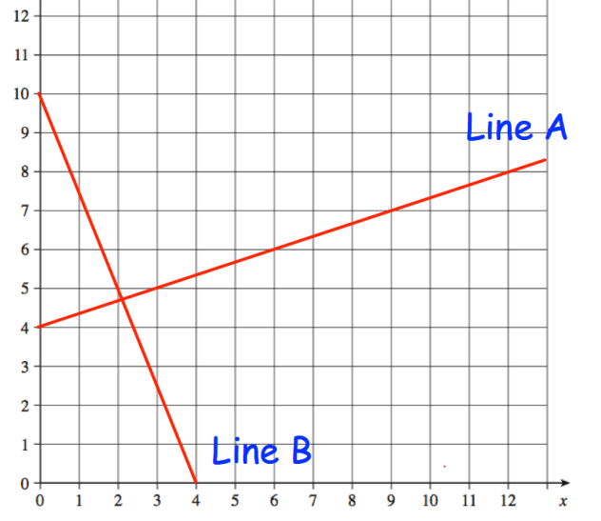
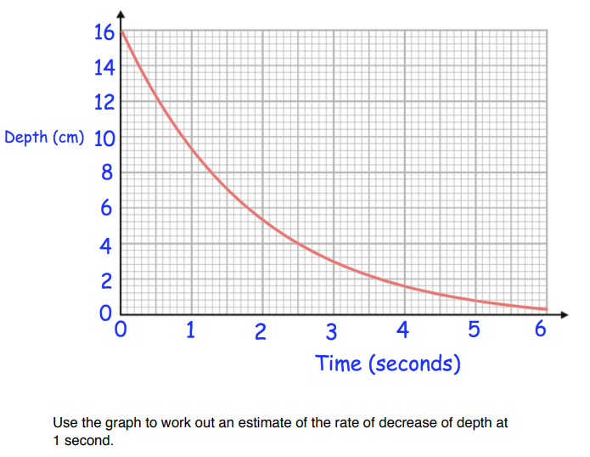

Gradient Under a Curve
$$Find the gradient of line a and b:$$
FOLLOW-UP WORK
Clip 887-890
https://www.mathsgenie.co.uk/gcse-may-june-2022-higher-topics.html
Gradient of Lines and Velocity-Time Graphs

Slide 22
Section C: Ratio & Proportion

Slide 23
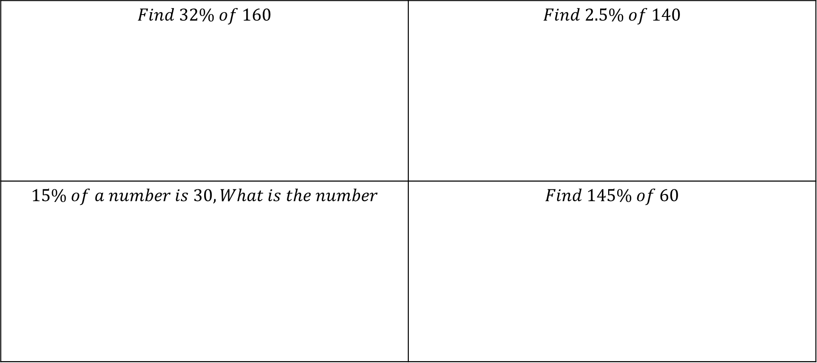
Percentages of an amount
$$Find 32\% of 160$$ | $$Find 2.5\% of 140$$
$$15\% of a number is 30, What is the number$$ | $$Find 145\% of 60$$
FOLLOW-UP WORK
Clip 84-86
https://www.mathsgenie.co.uk/gcse-may-june-2022-higher-topics.html
Percentages

Slide 24
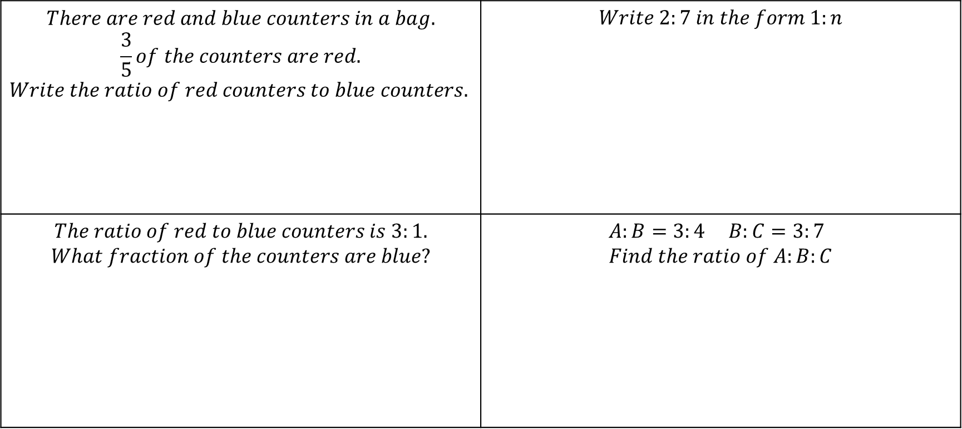
Use of Ratio & Ratio as fractions
$$There are red and blue counters in a bag.$$ $$\frac{3}{5}of the counters are red.$$ $Write the ratio of red counters to blue counters.$ | $$Write 2:7 in the form 1:n$$
$$The ratio of red to blue counters is 3:1.$$ $$What fraction of the counters are blue?$$ | $$A:B=3:4 B:C=3:7 \\ Find the ratio of A:B:C$$
FOLLOW-UP WORK
Clip 328-329; 335-338, 330
https://www.mathsgenie.co.uk/gcse-may-june-2022-higher-topics.html
Writing a Ratio as a Fraction or Linear Function

Slide 25
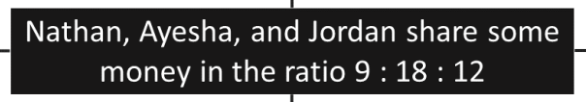
Sharing in a given ratio
Simplify the ratio | Divide £78 in this ratio.
Ayesha gets £18 more than Nathan. How much does Jordan get? | Nathan and Jordan have £105 together. What is the total amount?
FOLLOW-UP WORK
Clip 332-335
https://www.mathsgenie.co.uk/gcse-may-june-2022-higher-topics.html
Ratio

Slide 26
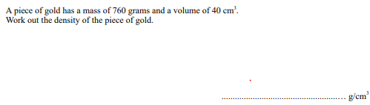
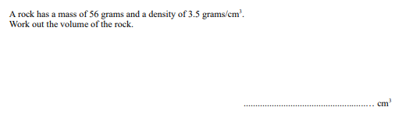
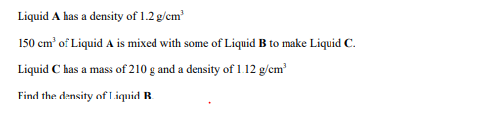

Density
FOLLOW-UP WORK
Clip 725-733
https://www.mathsgenie.co.uk/gcse-may-june-2022-higher-topics.html
Speed & Density

Slide 27
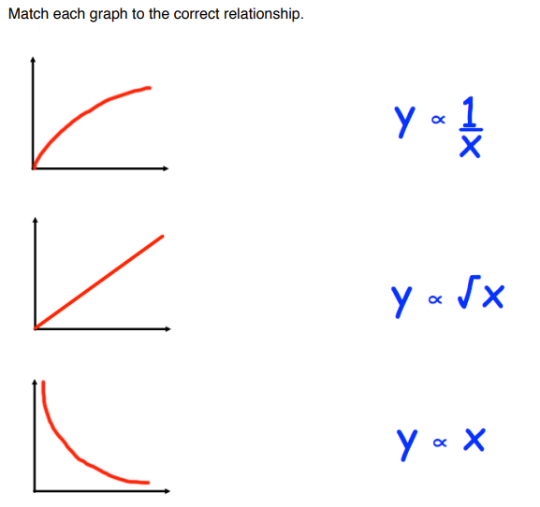
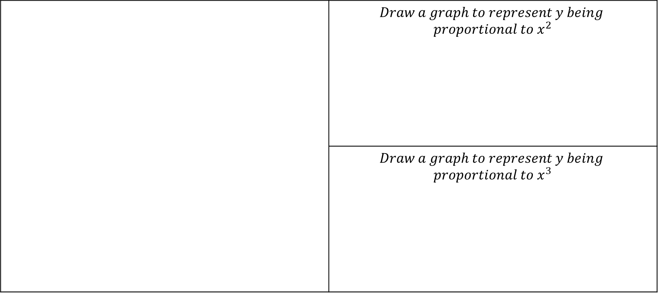
Equations of Proportion
 | $$Draw a graph to represent y being$$ $$proportional to x^{2}$$
 | $$Draw a graph to represent y being$$ $$proportional to x^{3}$$
FOLLOW-UP WORK
Clip 343-347
https://www.mathsgenie.co.uk/gcse-may-june-2022-higher-topics.html
Direct & Inverse Proportion

Slide 28
Section D: Geometry

Slide 29
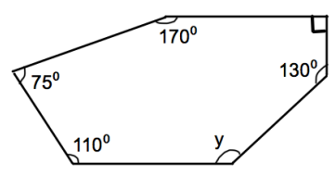
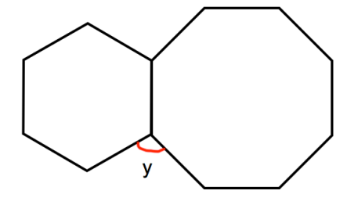
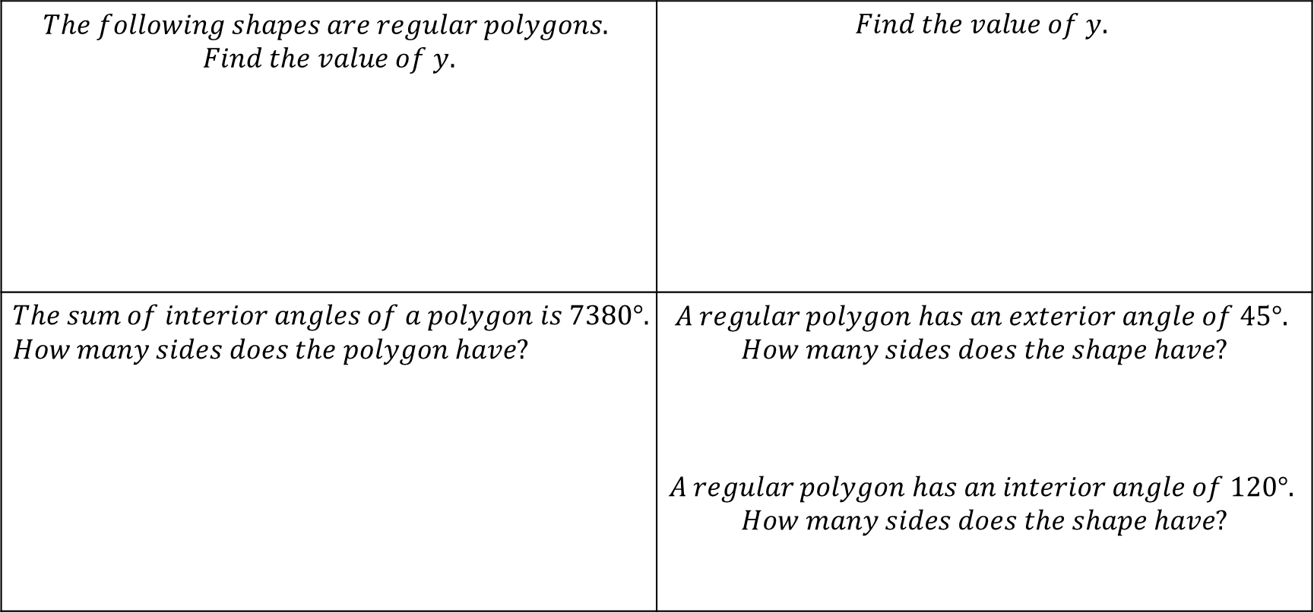
Angles in Polygons
$$The following shapes are regular polygons.$$ $$Find the value of y.$$ | $$Find the value of y.$$
$$The sum of interior angles of a polygon is 7380°. \\ How many sides does the polygon have?$$ | $$A regular polygon has an exterior angle of 45°.$$ $$How many sides does the shape have?$$ $$A regular polygon has an interior angle of 120°.$$ $$How many sides does the shape have?$$
FOLLOW-UP WORK
Clips 560-565
https://www.mathsgenie.co.uk/gcse-may-june-2022-higher-topics.html
Angles in Polygons

Slide 30
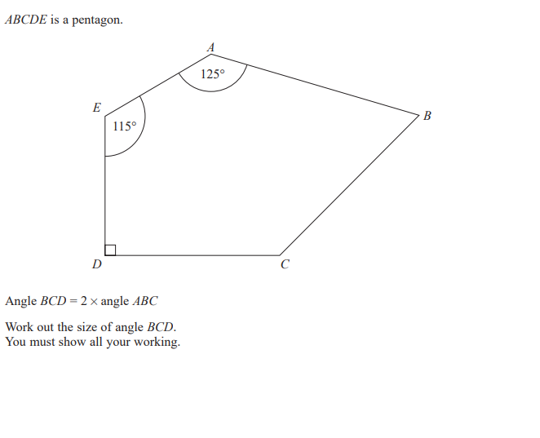
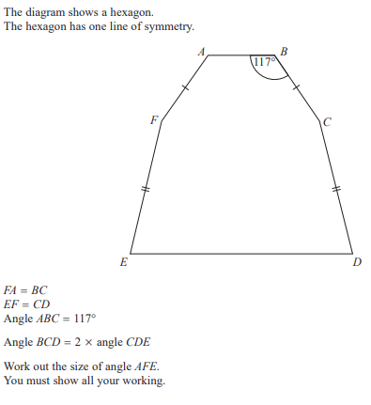
Angles in Polygons
FOLLOW-UP WORK
Clips 560-565
https://www.mathsgenie.co.uk/gcse-may-june-2022-higher-topics.html
Angles in Polygons

Slide 31
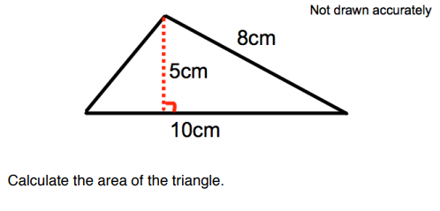
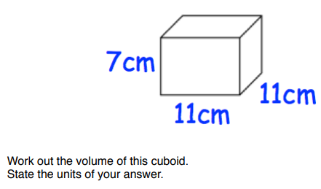
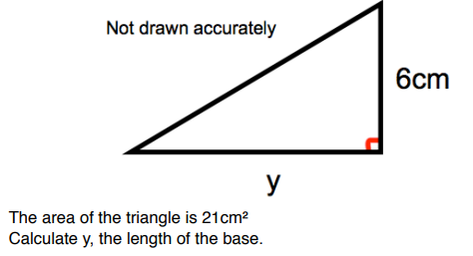
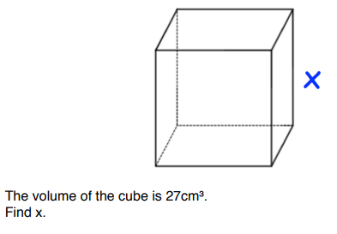
Area & Volume
FOLLOW-UP WORK
Clips 557-558; 568-569; 583
https://www.mathsgenie.co.uk/gcse-may-june-2022-higher-topics.html
Finding Area of any triangle and volume of prisms

Slide 32
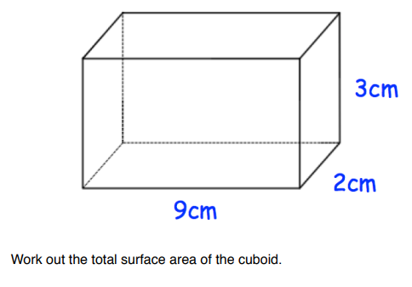
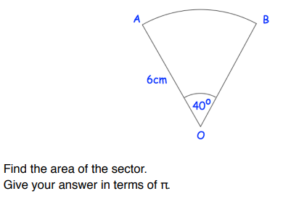
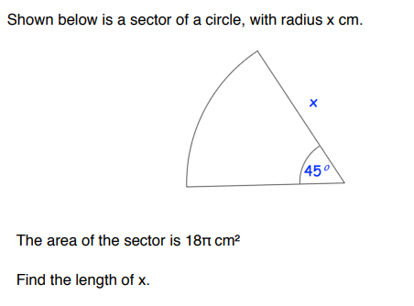
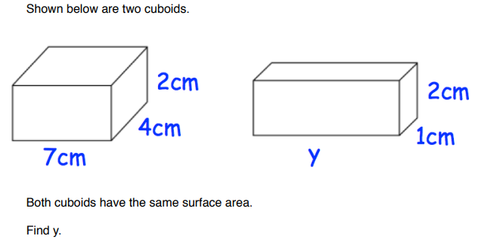
Area of Sectors & Surface Area
FOLLOW-UP WORK
Clips 546-547; 584, 589-590
https://www.mathsgenie.co.uk/gcse-may-june-2022-higher-topics.html
Sector Areas & Arc Length and Surface Area

Slide 33
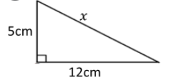
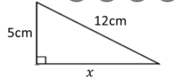


Pythagoras Theorem
$$Find x. \\ Leave your answer in surd form if neccessary$$ | $$Find x. \\ Leave your answer in surd form if neccessary$$
$$Find the length of the two missing sides. \\ Leave your answer in surd form if neccessary.$$ | $$Find the length of the line segment with \\ endpoints \left(2,4\right)and (5,8)$$
12cm
FOLLOW-UP WORK
Clips 497-507
https://www.mathsgenie.co.uk/gcse-may-june-2022-higher-topics.html
Pythagoras

Slide 34




Exact Trigonometric Values
$$YOU MUST LEARN THESE‼!$$
FOLLOW-UP WORK
Clip 845
https://www.mathsgenie.co.uk/gcse-may-june-2022-higher-topics.html
Exact Trig Values

Slide 35


Vector Geometry
FOLLOW-UP WORK
Clips 628-636
https://www.mathsgenie.co.uk/gcse-may-june-2022-higher-topics.html
Vectors

Slide 36
Section E: Probability & Statistics

Slide 37



Independent Combined Events
FOLLOW-UP WORK
Clips 351-359
https://www.mathsgenie.co.uk/gcse-may-june-2022-higher-topics.html
Probability Trees

Slide 38


Cumulative Frequency & IQR
 | $$c. Find an estiamte for the median$$ $$d. Find an estimate for the interquartile range$$ $$e. Estimate the fraction of the group who were$$ $$over 55?$$
FOLLOW-UP WORK
Clips 437-440, 412
https://www.mathsgenie.co.uk/gcse-may-june-2022-higher-topics.html
Cumulative Frequency and Boxplots

Slide 39

Mean
$$The mean of 4, 5, 7, 8, and x is 10.$$ $$What is the value of x?$$ | $$The mean of four numbers is 11.$$ $$If one number is removed and the mean is now 13,$$ $$What number was removed?$$
$$The mean of five numbers is 6.$$ $$If I add a sixth number, 12,$$ $$what is the new mean?$$ | $$The average number of cars in 60 households in Corby is 3$$ $$The average number of cars in 40 households in Kettering is 2$$ $$What is the mean number of cars in the 1000 households?$$
FOLLOW-UP WORK
Clips 405-408; 417-421
https://www.mathsgenie.co.uk/gcse-may-june-2022-higher-topics.html
Averages

