Slide 1
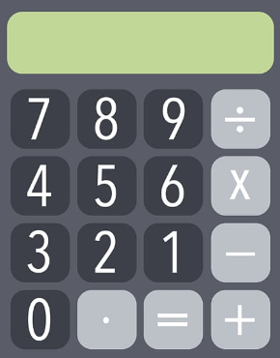
Year 11 – Paper 1 Revision Pack (Foundation)
Please attempt all questions without a calculator.
Friday 20th May 2021 - AM

Slide 2
How to use this revision pack
Review the list of topics that will appear on paper 1 of the summer exams. This can be found on the next page.
Work through the revision pages for each of the topics that will appear on the summer exams.
Use the electronic mark scheme to check your work and identify areas of weakness. The electronic mark scheme can be found on Teams and Satchel One.
Follow up with either:
Using the Hegarty Maths Clip Numbers to watch video tutorials on areas of weakness. You should then complete the quizzes on Hegarty to test whether you have closed your gap in knowledge.
OR
B. Follow the link for Maths Genie Exam Practice and search for the pack of questions relating to each topic (Mark Schemes Provided)
Each of these options is clearly labelled at the bottom of each page of revision.
You can also access whole past papers at https://corbettmaths.com/2022/02/28/edexcel-gcse-foundation-summer-2022/ You should select Advanced Information – Paper 1 (Set A and Set B)
Email your class teacher if you have any questions or require further resources. Email Mr Lee if you need help during the school holidays.

Slide 3
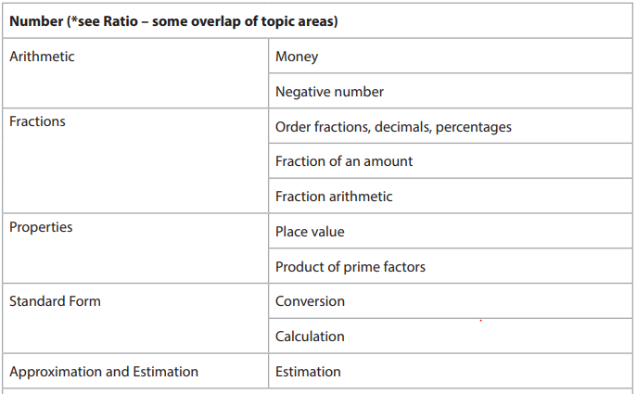
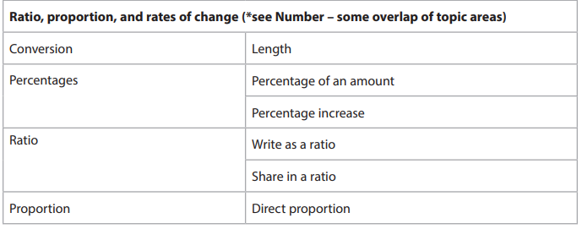
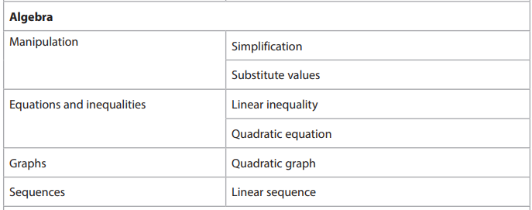
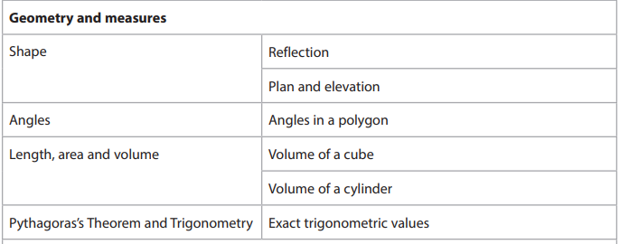
Advanced Information – 1F
Non-Calculator

Slide 4
Section A: Number

Slide 5
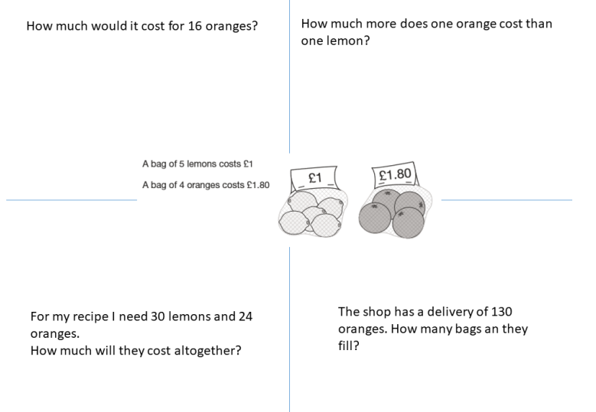
Money
FOLLOW-UP WORK
Clips 743-754
https://www.mathsgenie.co.uk/gcse-may-june-2022-foundation-topics.html

Slide 6
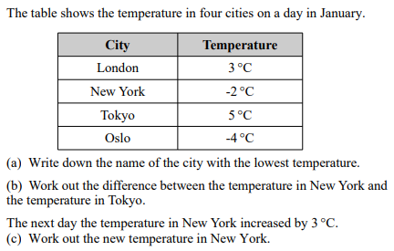
Negative Number
$$Work out \\ −5+4$$ $$−5 −4$$ $$3 −9$$ $$−12 −(−2)$$ | $$Work out \\ −5×4$$ $$−5 ×−4$$ $${(−7)}^{2}$$ $${(−2)}^{3}$$
$$Work out$$ $$−25 ÷5$$ $$−25 ÷−5$$
FOLLOW-UP WORK
Clips 37-44
https://www.mathsgenie.co.uk/gcse-may-june-2022-foundation-topics.html Negative Numbers

Slide 7
Ordering Fractions, Decimals & Percentages
$$Convert the following to decimals:$$ $$56\% 5\%$$ $$\frac{9}{10} \frac{7}{20}$$ | $$Convert the following to fractions:$$ $$0.67 0.07$$ $$56\% 5\%$$
$$Convert the following to percentages:$$ $$0.67 0.07$$ $$\frac{9}{10} \frac{7}{20}$$
FOLLOW-UP WORK
Clips 52, 55, 73-76, 82, 83, 149
https://www.mathsgenie.co.uk/gcse-may-june-2022-foundation-topics.html
Fractions, Decimals & Percentages

Slide 8
Fraction of an amount
Find 3/4 of 28. | Increase 28 by 3/4
3/4 of x is 33. Find x. | 3/4 of x is 12. Find 5/4 of x.
FOLLOW-UP WORK
Clip 77
https://www.mathsgenie.co.uk/gcse-may-june-2022-foundation-topics.html Fractions of an Amount

Slide 9
Fraction Arithmetic
$$2\frac{3}{4}×1\frac{2}{7}$$ | $$2\frac{3}{4}+1\frac{2}{7}$$
$$2\frac{3}{4}−1\frac{2}{7}$$ | $$2\frac{3}{4}÷1\frac{2}{7}$$
FOLLOW-UP WORK
Clips
65-70,80
https://www.mathsgenie.co.uk/gcse-may-june-2022-foundation-topics.html
Fractions

Slide 10
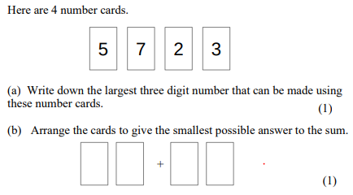
Place Value
$$Write down the value of 6 in the number 4654$$ $$Write down the value of 6 in the number 6054$$ | $$Write down the value of 6 in the number 304.6$$ $$Write down the value of 6 in the number 105.06$$
$$Write down a 5 digit even number that has 3 in \\ its thousands digit.$$ $You can only use the digit 3 once!$
FOLLOW-UP WORK
Clips 13, 45
https://www.mathsgenie.co.uk/gcse-may-june-2022-foundation-topics.html
Place Value

Slide 11
Product of prime factors
$$Express 50 as a product of prime factors$$ | $$Express 96 as a product of prime factors$$
$$Given that 40=2^{3}×5,$$ $$Express 80 as a product of prime factors$$ $$Express 400 as a produdct of prime factors$$ | $$Given that 20=2^{2}×5,$$ $$What is the smallest number you can multiply \\ 20 by to get a square number?$$
FOLLOW-UP WORK
Clip 29,30,32,35
https://www.mathsgenie.co.uk/gcse-may-june-2022-foundation-topics.html
Prime Factors, HCF & LCM

Slide 12
Standard Form
$$Write the following in standard form:$$ $$47 000 000$$ $$300 300$$ $$0.0007$$ $$45 ×{10}^{4}$$ | $$Write the following in ordinary form:$$ $$4.5 × {10}^{8}$$ $$2.003 × {10}^{4}$$ $$2 × {10}^{−5}$$
$$Work out:$$ $$(4.5 ×{10}^{7})×(3×{10}^{4})$$ $$(4.5 ×{10}^{7})÷(3×{10}^{4})$$ | $$Work out:$$ $$\left(4.5 ×{10}^{5}\right)+(3×{10}^{4})$$
FOLLOW-UP WORK
Clip 122-127
https://www.mathsgenie.co.uk/gcse-may-june-2022-foundation-topics.html Standard Form

Slide 13
Estimation
$$a. What square numbers does \sqrt{40} lie between?$$ b. $Estimate \sqrt{40}$ | $$Estimate:$$ $$\frac{3.54 ×105}{2.3}$$
$$Estimate:$$ $$\frac{31 ×46}{0.496}$$ | $$Mark gets paid £8.23 per hour. \\ Each week Mark works 42 hours. \\ Estimate how much money mark gets per week.$$ $$Is this an over or under estimate?Explain$$
FOLLOW-UP WORK
Clip 131
https://www.mathsgenie.co.uk/gcse-may-june-2022-foundation-topics.html Estimation

Slide 14
Section B: Algebra

Slide 15
Simplification
$$Simplify:$$ $$a+a+a+a$$ $$a ×a×a×a$$ $$3×a×2×b$$ $$3×a×2×a$$ | $$Simplify:$$ $$a−2a+6a$$ $$2a+3b+4a+b$$ $$2a−3b−4a+7b$$
$$Simplify:$$ $$a^{2}+a^{2}+a^{2}$$ $$7ab+2ab −3ab$$ | $$Simplify:$$ $$\frac{3x+5x}{2}$$
FOLLOW-UP WORK
Clips 156-159, 173, 174
https://www.mathsgenie.co.uk/gcse-may-june-2022-foundation-topics.html Simplifying Algebra

Slide 16
Substitution
$$If a=4 and b=5, work out:$$ $$a+b$$ $$3a+2b$$ $$a^{2}−b$$ | $$If a=−9 and b=3, work out:$$ $$a+b$$ $$3a+2b$$ $$a^{2}−b$$
$$When a=5 and b=−2, work out$$ $${2a}^{2}$$ $$b^{2}+a$$ | $$v=u+at:$$ $$Find v when u=2, a=\frac{1}{2} and t=−10$$
FOLLOW-UP WORK
Clips 155, 278, 780-783
https://www.mathsgenie.co.uk/gcse-may-june-2022-foundation-topics.html Substitution

Slide 17
Inequalities
$$Solve 4x −1 ≥10$$ | $$Solve 4x −1 ≥2x+11$$
$$a.Represent the following on a number line:$$ $$2<x ≤5$$ $$b. List the integers that satisfy this inequality.$$ | $$Represent the following on a number line:$$ $$−3<2x −1 ≤7$$
FOLLOW-UP WORK
Clips 265-272
https://www.mathsgenie.co.uk/gcse-may-june-2022-foundation-topics.html Inequalities

Slide 18
Quadratic Equations
$$Solve:$$ $$(x−4)(x+2)=0$$ | $$Solve:$$ $$x^{2}−10x+16=0$$
$$Solve:$$ $$x^{2}−x−6=0$$ | $$Solve:$$ $$x^{2}=5x+24$$
FOLLOW-UP WORK
Clips 230-234
https://www.mathsgenie.co.uk/gcse-may-june-2022-foundation-topics.html Solving Quadratics

Slide 19
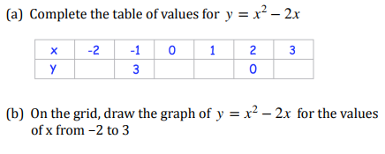
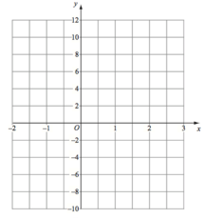
Quadratic Graphs
 | $b. Find the coordinates of the turning point$ $$c. Find the roots of y= x^{2}−2x$$ $$d. \text{Find} \text{an} \text{estimate} \text{to} x^{2}−2x=6$$
FOLLOW-UP WORK
Clips 251-255
https://www.mathsgenie.co.uk/gcse-may-june-2022-foundation-topics.html Drawing Quadratic Graphs

Slide 20
Linear Sequences
$$Find the next three terms of the following \\ linear sequences:$$ $$4, 9, 14, 19, …$$ $$2.7, 3.3, 3.9, …$$ $$40, 33, 26, 19,…$$ | $$Find the nth term of the following \\ linear sequences:$$ $$3, 7, 11, 15, …$$ $$−10, −4, 2, …$$ $$9, 7, 5, 3, …$$
$$Find the 5th term of the following sequences:$$ $$4n −9$$ $$1 −3n$$ | $$Determine whether 50 is in the sequence with \\ nth term 5n+4. Explain your reasoning.$$ $$Determine whether 59 is in the sequence with \\ nth term 5n+4. Explain your reasoning.$$
FOLLOW-UP WORK
Clips 196-198
https://www.mathsgenie.co.uk/gcse-may-june-2022-foundation-topics.html Sequences (Nth Term)

Slide 21
Section C: Statistics

Slide 22
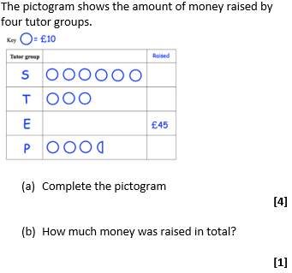
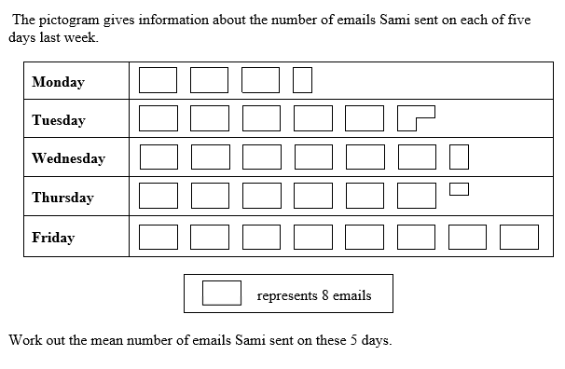
Pictograms
FOLLOW-UP WORK
Clip 426
https://www.mathsgenie.co.uk/gcse-may-june-2022-foundation-topics.html Pictograms

Slide 23
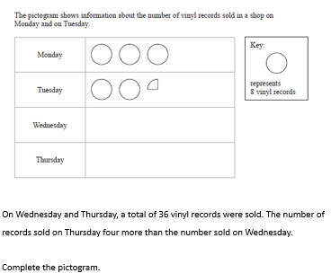
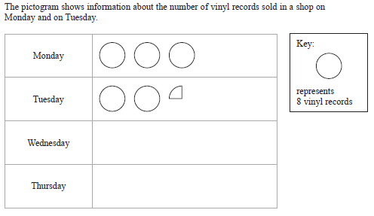
Pictograms
FOLLOW-UP WORK
Clip 426
https://www.mathsgenie.co.uk/gcse-may-june-2022-foundation-topics.html Pictograms

Slide 24
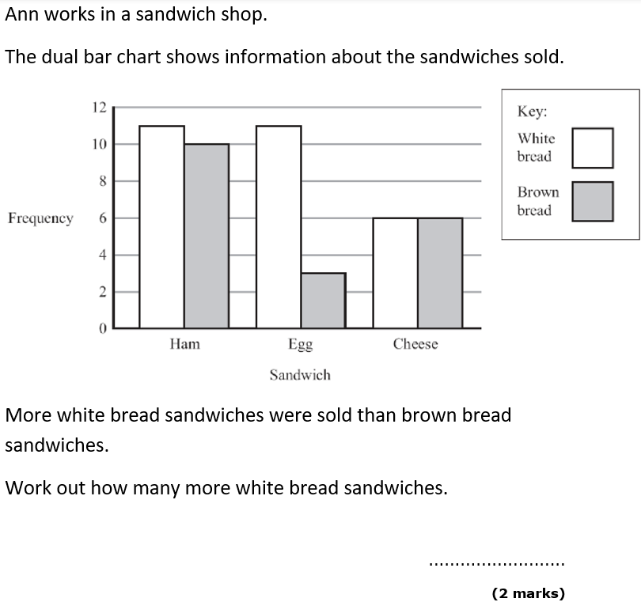
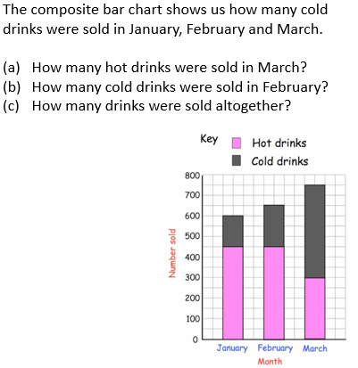
Bar Charts
FOLLOW-UP WORK
Clip 425
https://www.mathsgenie.co.uk/gcse-may-june-2022-foundation-topics.html
Bar Charts

Slide 25
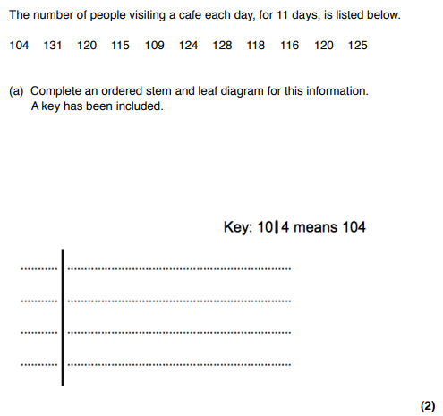
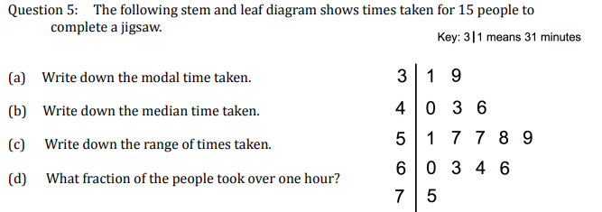
Stem and Leaf
FOLLOW-UP WORK
Clips 430-433
https://www.mathsgenie.co.uk/gcse-may-june-2022-foundation-topics.html
Stem and Leaf

Slide 26
Section D:
Ratio, Proportion & Rates of Change

Slide 27
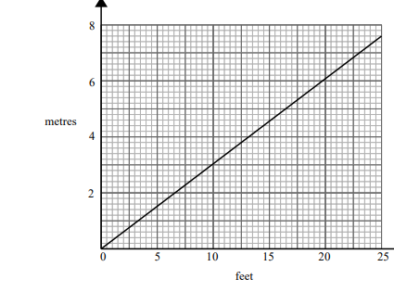
Conversion
$$Convert the following:$$ $$2.5m into cm$$ $$32cm into mm$$ $$345cm into m$$ | $$Convert the following:$$ $$3m into mm$$
$$Convert the following:$$ $$2.5km into m$$ $$1005m into km$$
$$a.Change 12 feet into metres$$
$$b. Change 25 metres into feet.$$
FOLLOW-UP WORK
Clips 692-694, 705-706
https://www.mathsgenie.co.uk/gcse-may-june-2022-foundation-topics.html
Conversion and Units

Slide 28
Percentages of an amount
$$Find 32\% of 160$$ | $$Find 2.5\% of 140$$
$$15\% of a number is 30, What is the number?$$ | $$Find 145\% of 60$$
FOLLOW-UP WORK
Clip 84-86
https://www.mathsgenie.co.uk/gcse-may-june-2022-foundation-topics.html
Percentages

Slide 29
Percentage Increase
$$Increase 40 by 10\%$$ | $$Increase 36 by 11\%$$
$$Working out 153 ×1.03$$ $$is the same as increasing by what \%?$$ | $$Working out 153 ×1.005$$ $$is the same as increasing by what \%?$$
FOLLOW-UP WORK
Clips 88, 91-92, 94, 97-98
https://www.mathsgenie.co.uk/gcse-may-june-2022-foundation-topics.html
Percentages

Slide 30
Use of Ratio & Ratio as fractions
$$In Y7 there are 40 left handed students and 160 \\ right handed students. \\ Write the ratio of left handed to right handed$$ $students in its simplest form$. | $$There are red and blue counters in a bag.$$ $$\frac{3}{5}of the counters are red.$$ $Write the ratio of red counters to blue counters.$
$$The ratio of red to blue counters is 3:1.$$ $$What fraction of the counters are blue?$$ | $$Write 2:7 in the form 1:n$$
FOLLOW-UP WORK
Clips 328-329
https://www.mathsgenie.co.uk/gcse-may-june-2022-foundation-topics.html
Writing and Simplifying Ratio

Slide 31
Sharing in a given ratio
Simplify the ratio | Divide £78 in this ratio.
Ayesha gets £18 more than Nathan. How much does Jordan get? | Nathan and Jordan have £105 together. What is the total amount?
FOLLOW-UP WORK
Clip 332-335
https://www.mathsgenie.co.uk/gcse-may-june-2022-foundation-topics.html
Ratio

Slide 32
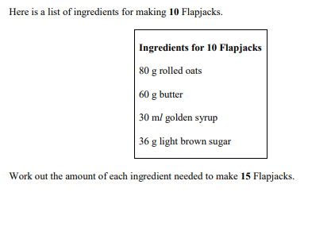
Direct Proportion
 | $$If I have: \\ 240g of rolled oats, \\ 150g of butter, \\ 150ml of golden syrup \\ 360g of light brown sugar, \\ what is the largest number of flapjacks I can make?$$
FOLLOW-UP WORK
Clips 339-341, 343-345, 348, 739-742
https://www.mathsgenie.co.uk/gcse-may-june-2022-foundation-topics.html
Proportion

Slide 33
Density
FOLLOW-UP WORK
Clip 725-729
https://www.mathsgenie.co.uk/gcse-may-june-2022-foundation-topics.html
Speed and Density

Slide 34
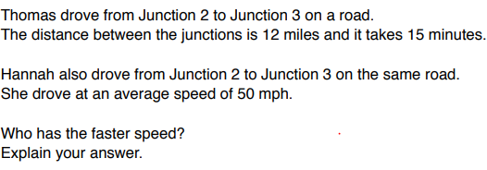
Speed
FOLLOW-UP WORK
Clip 716-724
https://www.mathsgenie.co.uk/gcse-may-june-2022-foundation-topics.html
Speed and Density

Slide 35
Section E: Geometry

Slide 36
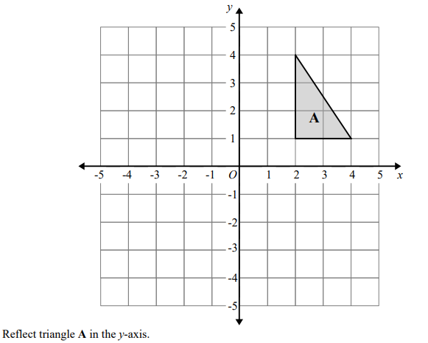
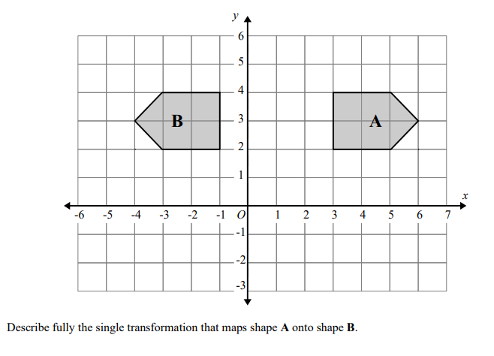
Reflection
FOLLOW-UP WORK
Clips 639-641
https://www.mathsgenie.co.uk/gcse-may-june-2022-foundation-topics.html
Reflections

Slide 37
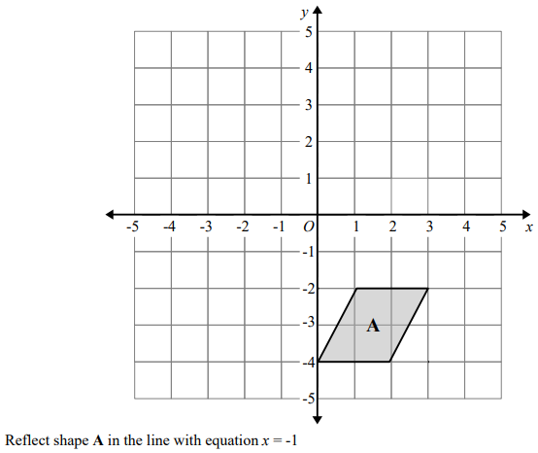
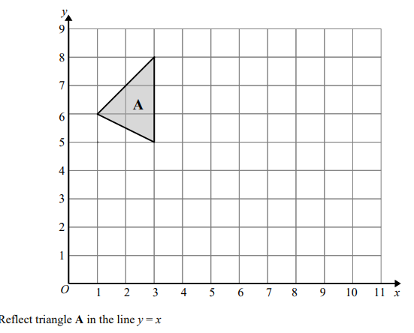
Reflection
FOLLOW-UP WORK
Clips 639-641
https://www.mathsgenie.co.uk/gcse-may-june-2022-foundation-topics.html
Reflections

Slide 38
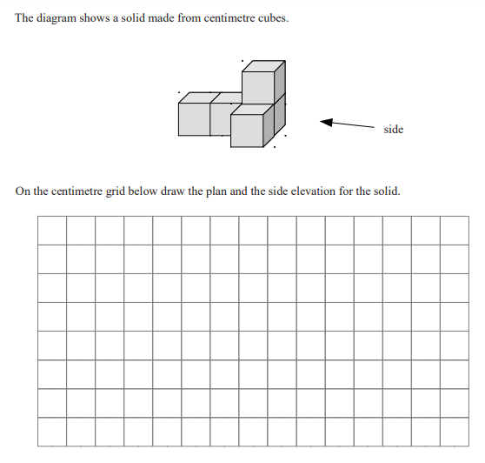
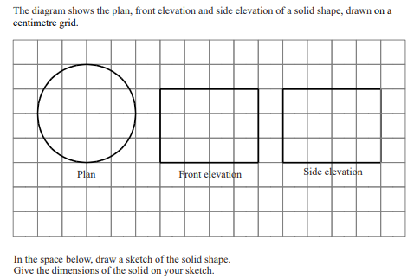
Plans & Elevation
FOLLOW-UP WORK
Clips 837-844
https://www.mathsgenie.co.uk/gcse-may-june-2022-foundation-topics.html
Plans and Elevations

Slide 39
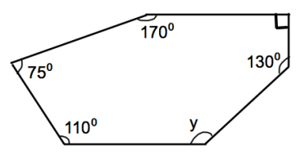
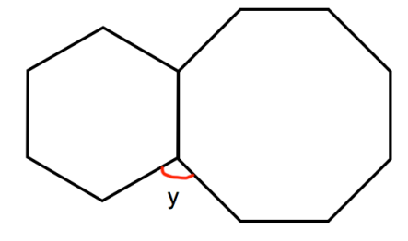
Angles in Polygons
$$The following shapes are regular polygons.$$ $$Find the value of y.$$ | $$Find the value of y.$$
$$The sum of interior angles of a polygon is 7380°. \\ How many sides does the polygon have?$$ | $$A regular polygon has an exterior angle of 45°.$$ $$How many sides does the shape have?$$ $$A regular polygon has an interior angle of 120°.$$ $$How many sides does the shape have?$$
FOLLOW-UP WORK
Clips 560-565
https://www.mathsgenie.co.uk/gcse-may-june-2022-higher-topics.html
Angles in Polygons

Slide 40
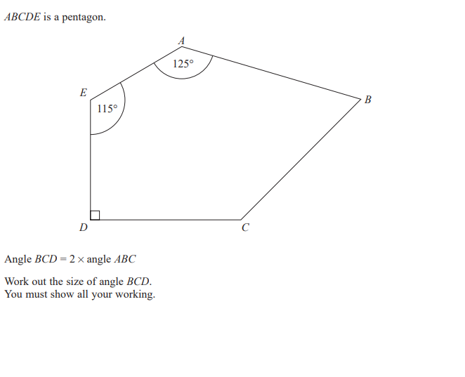
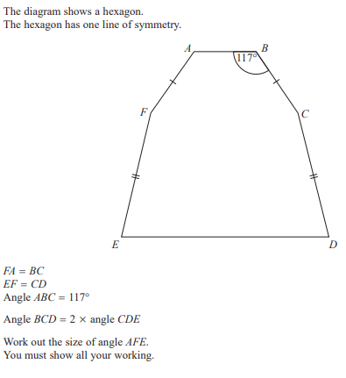
Angles in Polygons
FOLLOW-UP WORK
Clips 560-565
https://www.mathsgenie.co.uk/gcse-may-june-2022-foundation-topics.html
Angles in Polygons

Slide 41
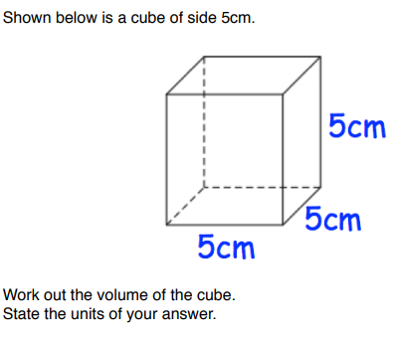
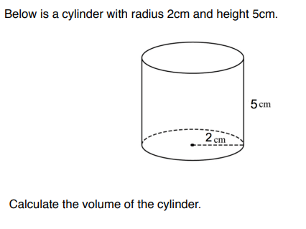
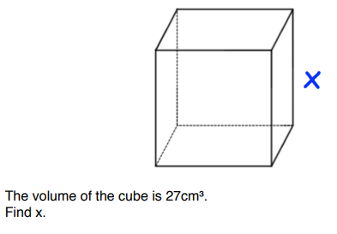
Volume
Give your answers in terms of π
FOLLOW-UP WORK
Clips 568-569, 572-574
https://www.mathsgenie.co.uk/gcse-may-june-2022-foundation-topics.html
Volume of a prism; Cylinders

Slide 42
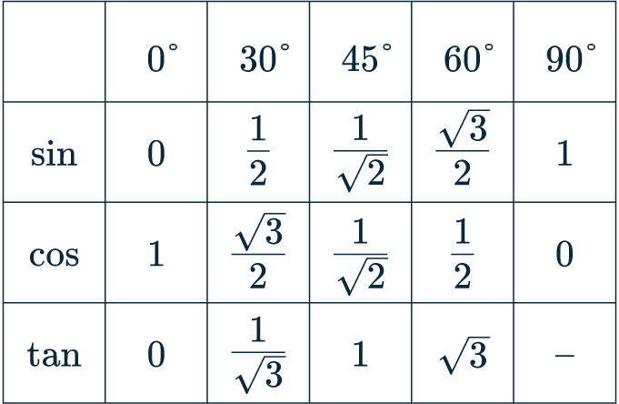
Exact Trigonometric Values
$$YOU MUST LEARN THESE‼!$$
FOLLOW-UP WORK
Clip 845
https://www.mathsgenie.co.uk/gcse-may-june-2022-foundation-topics.html
Exact Trig Values

Slide 43
Section F: Probability

Slide 44
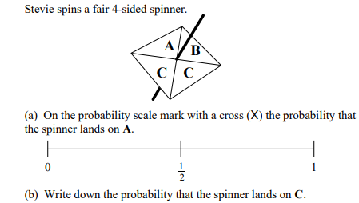
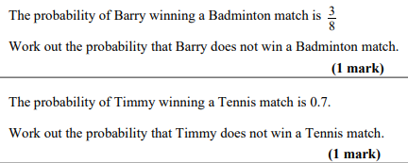
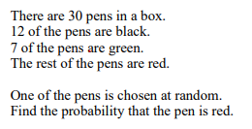
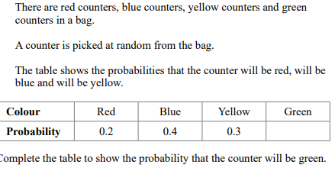
Probability
FOLLOW-UP WORK
Clips 349-363
https://www.mathsgenie.co.uk/gcse-may-june-2022-foundation-topics.html
Probability

Slide 45
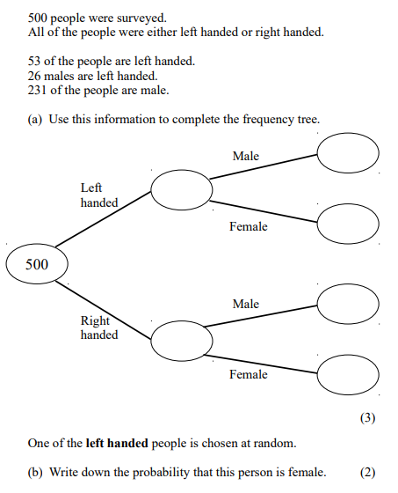
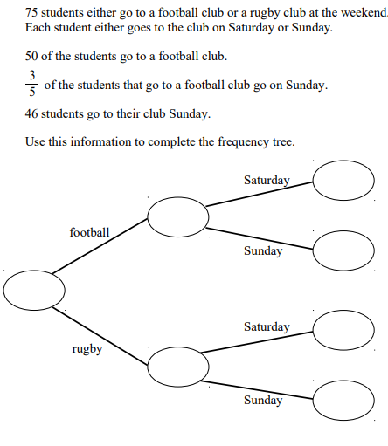
Frequency Tree
FOLLOW-UP WORK
Clips 368-369
https://www.mathsgenie.co.uk/gcse-may-june-2022-foundation-topics.html

