Slide 1
Year 11 – Paper 2 & 3 Revision Pack (Higher)
Please attempt all questions with a calculator.
Paper 2: Tuesday 7th June 2022
Paper 3: Monday 13th June 2022

Slide 2
How to use this revision pack
Review the list of topics that will appear on paper 2 and 3 of the summer exams. The booklet is divided into two parts; the first half is preparation for paper 2 and the second half is for paper 3.
Work through the revision pages for each of the topics that will appear on the summer exams.
Use the electronic mark scheme to check your work and identify areas of weakness. The electronic mark scheme can be found on Teams and Satchel One.
Follow up with either:
Using the Hegarty Maths Clip Numbers to watch video tutorials on areas of weakness. You should then complete the quizzes on Hegarty to test whether you have closed your gap in knowledge.
OR
B. Follow the link for Maths Genie Exam Practice and search for the pack of questions relating to each topic (Mark Schemes Provided)
Each of these options is clearly labelled at the bottom of each page of revision.
You can also access whole past papers at https://corbettmaths.com/2022/02/28/edexcel-gcse-higher-summer-2022/ You should select Advanced Information – Paper 2 and 3 (Set A and Set B)
Email your class teacher if you have any questions.

Slide 3
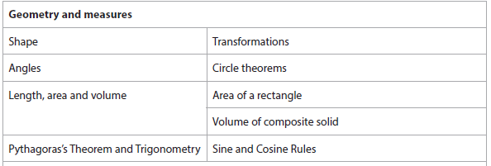
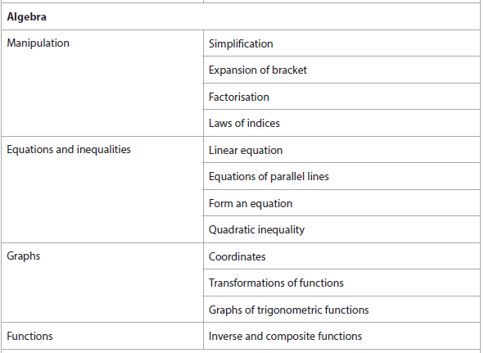
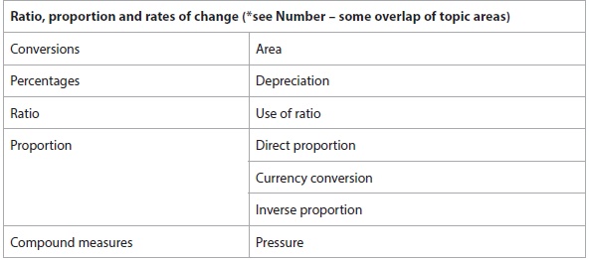
Advanced Information – 2H
Calculator

Slide 4
Section A: Number

Slide 5
Error Intervals
$$A number that has been rounded to the nearest$$ $hundred is 500. Write this as an error interval$. $…≤x < …$ | $$A number that has been rounded to 2 decimal$$ places is 1.46. $Write this as an error interval$. $…≤x < …$
$$A number that has been rounded to 2 significant$$ figures is 2400. Write this as an error interval. $…≤x < …$ | $$A number that has been truncated to 1 decimal$$ place is 1.5. $Write this as an error interval$. $…≤x < …$
FOLLOW-UP WORK
Clips 774-777
https://www.mathsgenie.co.uk/gcse-may-june-2022-higher-topics.html
Error Intervals

Slide 6
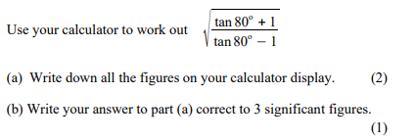
Calculator Use (Inc. Square Roots and rounding)
FOLLOW-UP WORK
Clip 129
https://www.mathsgenie.co.uk/gcse-may-june-2022-higher-topics.html Using a calculator

Slide 7
Section B: Algebra
Simplification and Expansion of a Bracket were also in Paper 1. Please use your old booklet to revise this topic.

Slide 8
Factorisation
$$Factorise:$$ $$x^{2}+25x$$ $$2x^{2}y+10xy$$ $$4x^{3}−10x$$ | $$Factorise:$$ $$x^{2}−10x+21$$ $$x^{2}−4x−21$$
$$Factorise:$$ $$3x^{2}−7x−20$$ | $$Factorise:$$ $${(x+y)}^{3}+3(x+y)$$
FOLLOW-UP WORK
Clips 168-171; 223-228
https://www.mathsgenie.co.uk/gcse-may-june-2022-higher-topics.html Expanding and Factorising; Expanding and Factorising Quadratics

Slide 9
Laws of Indices
$$Simplify:$$ $$x^{5}÷x^{9}$$ $$x^{−3}×x^{9}$$ $${{(x}^{4})}^{5}$$ | $$Simplify:$$ $$4x^{9}{yz}^{3}÷{2x}^{3}yz$$ $${5x}^{4}y^{3}×x^{7}y^{2}$$ $$({3xy^{5})}^{4}$$
$$Evaluate:$$ $$5^{4}$$ $$5^{0}$$
FOLLOW-UP WORK
Clips 173-175
https://www.mathsgenie.co.uk/gcse-may-june-2022-higher-topics.html
Indices

Slide 10
Linear Equations
$$Solve \frac{3x}{4}+2=8$$ $$Solve \frac{3x+2}{4}=3.5$$ | $$Solve 4x −1=2x+9$$
$$Solve 10 −3x=2x −5$$ | $$Solve \frac{3x−1}{2}=\frac{5x+10}{4}$$
FOLLOW-UP WORK
Clips 177-189
https://www.mathsgenie.co.uk/gcse-may-june-2022-higher-topics.html
Solving Equations

Slide 11
Equations of Parallel Lines
$$What is the gradient of a line parallel to:$$ $$y=3x −7$$ $$2y=7x+1$$ $$3y−2x=10$$ | $$Find the equation of a line parallel to \\ y=4x+6, that passes through (5,−4)$$
$$Find the equation of a line parallel to \\ 2y+5x=6, that passes through (−2,3)$$ | $$Line A passes through \left(2,−1\right)and \left(4,10\right) \\ Find the equation of the line parallel to A \\ that passes through (2,7)$$
FOLLOW-UP WORK
Clip 214
https://www.mathsgenie.co.uk/gcse-may-june-2022-higher-topics.html
Parallel & Perpendicular Lines

Slide 12
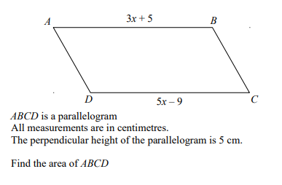
Form an Equation
FOLLOW-UP WORK
Clip 176
https://www.mathsgenie.co.uk/gcse-may-june-2022-higher-topics.html
Forming and Solving Equations

Slide 13
Quadratic Inequality
$$Solve x^{2}−x −20<0$$ | $$Solve x^{2}−5x −24≥0$$
$$Solve x^{2}−49<0$$ | $$Solve 6x+27>x^{2}$$
FOLLOW-UP WORK
Clip 277
https://www.mathsgenie.co.uk/gcse-may-june-2022-higher-topics.html
Quadratic Inequalities

Slide 14
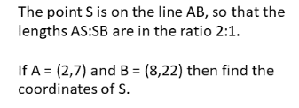
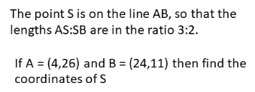
Coordinates
$$What is the midpoint of \left(5,−2\right)and \left(11, 4\right)?$$ | $$What is the length of the line segment joined by \\ \left(5,−2\right)and \left(11, 4\right)?$$
FOLLOW-UP WORK
Clips 199-200
https://www.mathsgenie.co.uk/gcse-may-june-2022-higher-topics.html
Coordinates

Slide 15
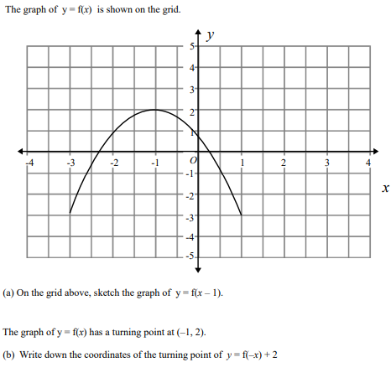
Transformation of Functions
$$Write down the coordinates of the maximum \\ point of the curve with the equation:$$ $$a. y f\left(x+3\right) \\ b. y=−f\left(x\right) \\ c. y=f\left(x\right)−3 \\ d. y=f\left(−x\right) \\ e. y=3f\left(x\right)$$ $f. y=f(2x)$
FOLLOW-UP WORK
Clips 307-313
https://www.mathsgenie.co.uk/gcse-may-june-2022-higher-topics.html
Transforming Graphs

Slide 16
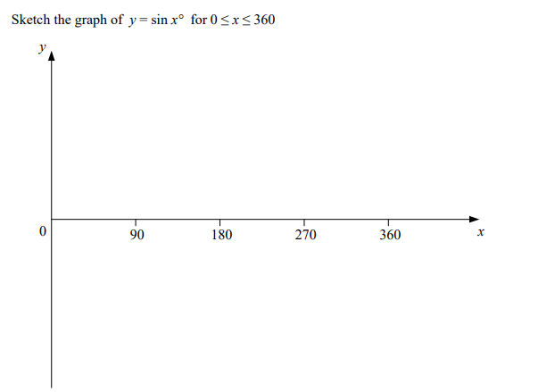
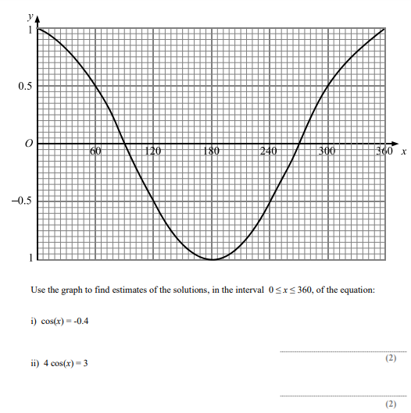
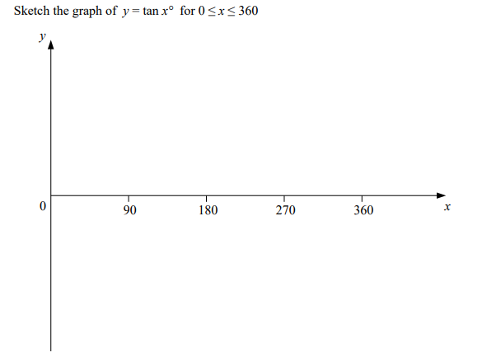
Graphs of Trigonometric Functions
FOLLOW-UP WORK
Clips 303-306
https://www.mathsgenie.co.uk/gcse-may-june-2022-higher-topics.html
Trigonometric and Exponential Graphs

Slide 17
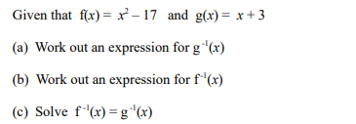
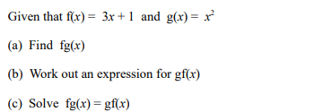
Inverse & Composite Functions
FOLLOW-UP WORK
Clips 293-297
https://www.mathsgenie.co.uk/gcse-may-june-2022-higher-topics.html
Inverse and Composite Functions

Slide 18
Section C:
Ratio, Proportion & Rates of Change
Use of Ratio was also in Paper 1. Please use your old booklet to revise this topic.

Slide 19
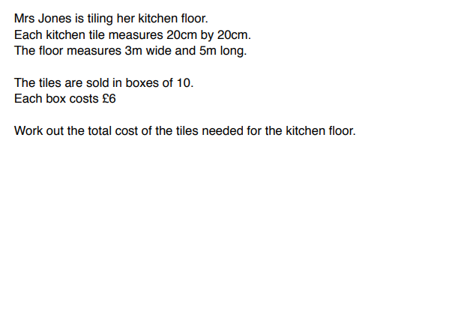
Area Conversion
$$Convert the following:$$ $$2.5m^{2} into {cm}^{2}$$ $$27cm^{2} into {mm}^{2}$$ $$7m^{2} into {mm}^{2}$$ | $$Hint:In these questions, it is more useful to \\ convert at the beginning of the question.$$
$$Convert the following:$$ $$240cm^{2} into m^{2}$$ $$2700mm^{2} into {cm}^{2}$$ $$40000mm^{2} into m^{2}$$
FOLLOW-UP WORK
Clips 700-701
https://www.mathsgenie.co.uk/gcse-may-june-2022-higher-topics.html
Conversions and Units

Slide 20
Depreciation
$$How do you represent a decrease of 12\% as a \\ multiplier?$$ $$How do you represent a decrease of 5\% as a \\ multiplier?$$ | $$A car costing £15,000 depreciates in value by x\% \\ each year. \\ After 5 years it is worth £10 000?$$ $$What is the rate of depreciation?(1d.p)$$ $$What assumption has been made?$$
$$A car costing £15,000 depreciates in value by 15\% \\ each year. \\ How much will it be worth after 3 years?$$ $$How many years does it take the are to half in \\ value?$$
FOLLOW-UP WORK
Clips 95; 808-811
https://www.mathsgenie.co.uk/gcse-may-june-2022-higher-topics.html
Compound Interest and Depreciation

Slide 21
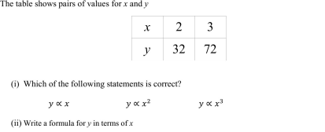
Direct Proportion
FOLLOW-UP WORK
Clips 339, 340, 341, 343, 344, 345, 348, 739 – 742
https://www.mathsgenie.co.uk/gcse-may-june-2022-higher-topics.html
Direct and Inverse Proportion

Slide 22
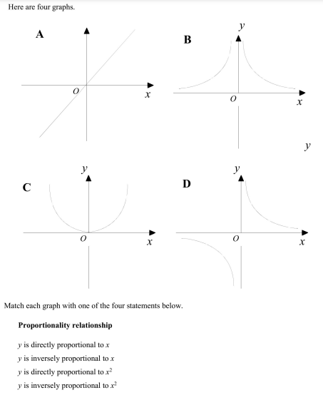
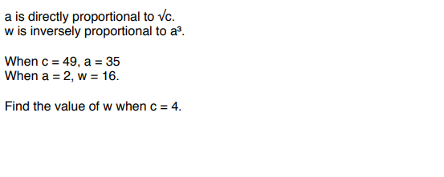
Inverse Proportion
FOLLOW-UP WORK
Clips 342; 346-348
https://www.mathsgenie.co.uk/gcse-may-june-2022-higher-topics.html
Direct and Inverse Proportion

Slide 23
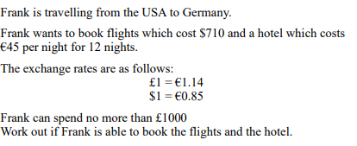
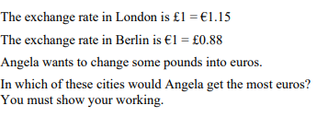
Currency Conversion
FOLLOW-UP WORK
Clips 707-708
https://www.mathsgenie.co.uk/gcse-may-june-2022-higher-topics.html
Exchange Rates

Slide 24
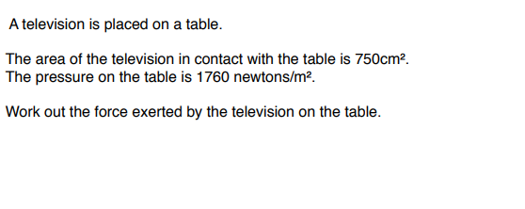
Pressure
 | $$Hint:The Area needs to be converted to m^{2}.$$
FOLLOW-UP WORK
Clips 734-737
https://www.mathsgenie.co.uk/gcse-may-june-2022-higher-topics.html

Slide 25
Section D:
Geometry & Measures

Slide 26
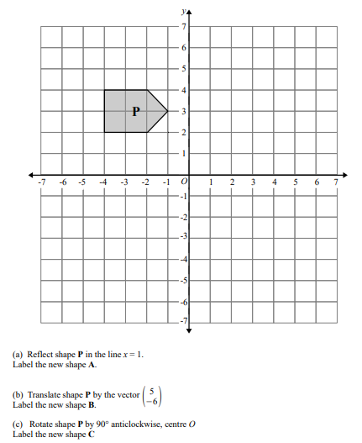
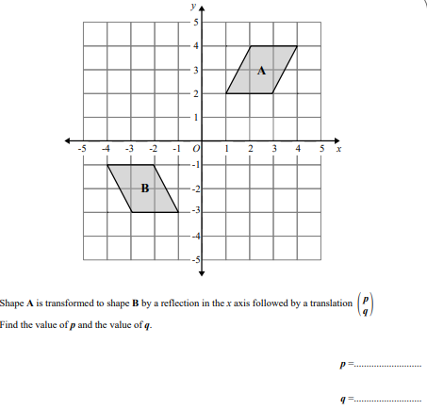
Transformations
FOLLOW-UP WORK
Clips 637-657
https://www.mathsgenie.co.uk/gcse-may-june-2022-higher-topics.html
Transformations

Slide 27
Describing Transformations
Describe what single transformation maps shape A to Shape B.
FOLLOW-UP WORK
Clips 637-657
https://www.mathsgenie.co.uk/gcse-may-june-2022-higher-topics.html
Transformations

Slide 28
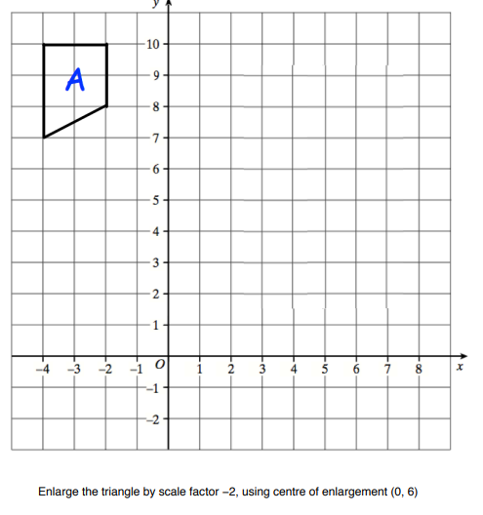
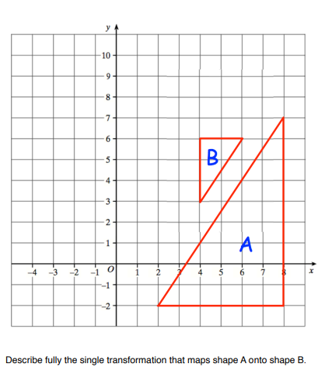
Transformations
FOLLOW-UP WORK
Clips 637-657
https://www.mathsgenie.co.uk/gcse-may-june-2022-higher-topics.html
Transformations

Slide 29
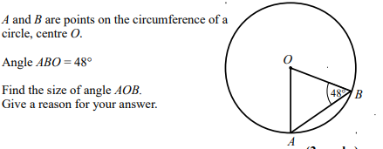
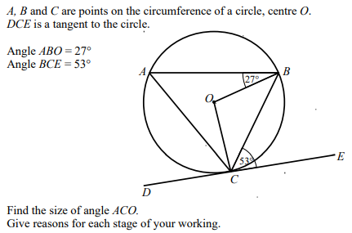
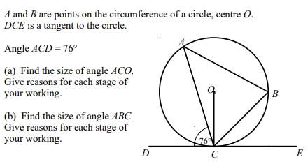
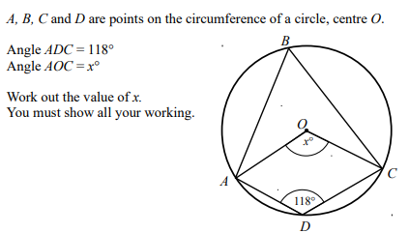
Circle Theorems
FOLLOW-UP WORK
Clips 593 – 606, 816 – 820
https://www.mathsgenie.co.uk/gcse-may-june-2022-higher-topics.html
Circle Theorems

Slide 30
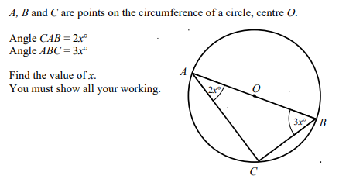
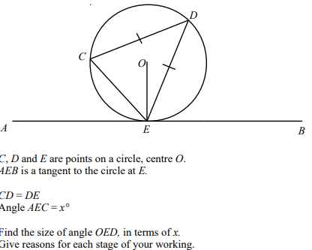
Circle Theorems (Harder)
FOLLOW-UP WORK
Clips 593 – 606, 816 – 820
https://www.mathsgenie.co.uk/gcse-may-june-2022-higher-topics.html
Circle Theorems

Slide 31
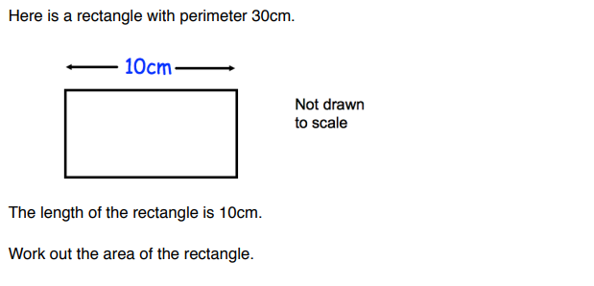
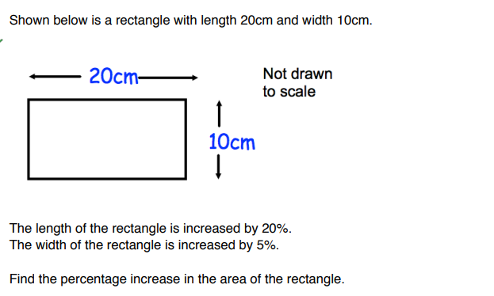
Area of a rectangle
FOLLOW-UP WORK
Clips 544-555
https://www.mathsgenie.co.uk/gcse-may-june-2022-higher-topics.html
Area and Perimeter

Slide 32
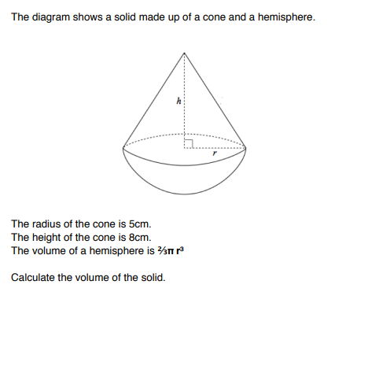
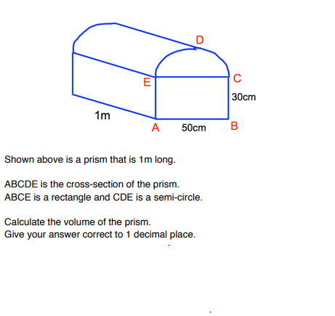
Volume of a Composite Solid
FOLLOW-UP WORK
Clips 582
https://www.mathsgenie.co.uk/gcse-may-june-2022-higher-topics.html

Slide 33
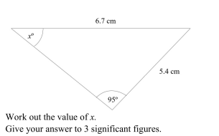
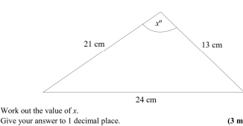
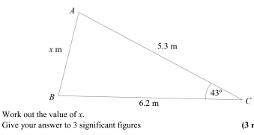
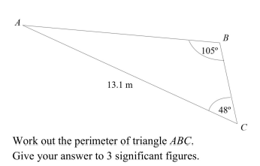
Sine & Cosine Rules
FOLLOW-UP WORK
Clips 521-533
https://www.mathsgenie.co.uk/gcse-may-june-2022-higher-topics.html
The Sine Rule; The Cosine Rule

Slide 34
Section E: Probability

Slide 35
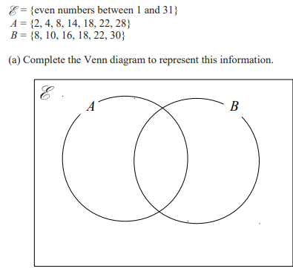
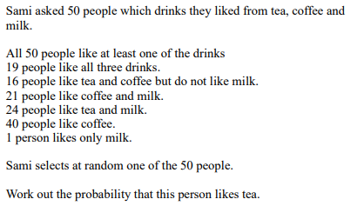
Venn Diagrams
$$\left(b\right)Find P\left(A∪B\right)$$ $$\left(c\right)List the elements A∩B$$ $$\left(d\right)Find P(A^{′})$$
FOLLOW-UP WORK
Clips 372-380
https://www.mathsgenie.co.uk/gcse-may-june-2022-higher-topics.html
Venn Diagrams

Slide 36
Section F: Statistics

Slide 37
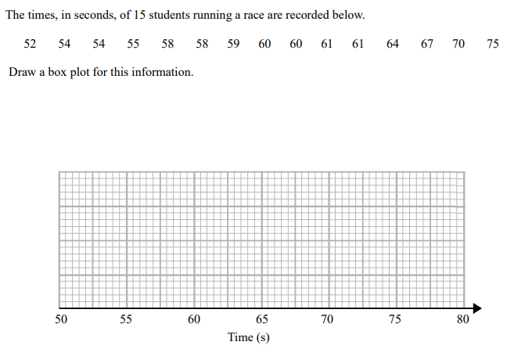
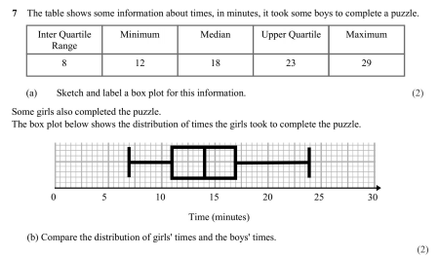
Box Plots/Quartiles/Comparing Distributions
FOLLOW-UP WORK
Clips 434-436; 440; 411; 432-433; 439
https://www.mathsgenie.co.uk/gcse-may-june-2022-higher-topics.html
Box Plots

Slide 38
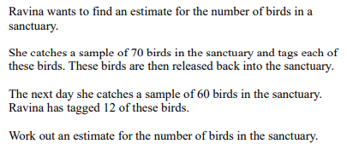
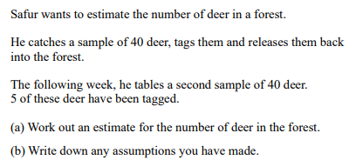
Capture/Recapture
FOLLOW-UP WORK
Clips 872-873
https://www.mathsgenie.co.uk/gcse-may-june-2022-higher-topics.html
Capture Recapture

Slide 39
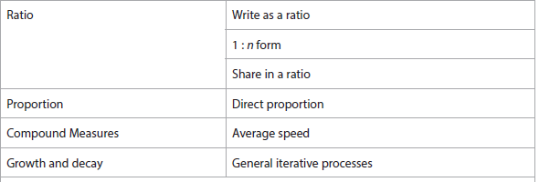
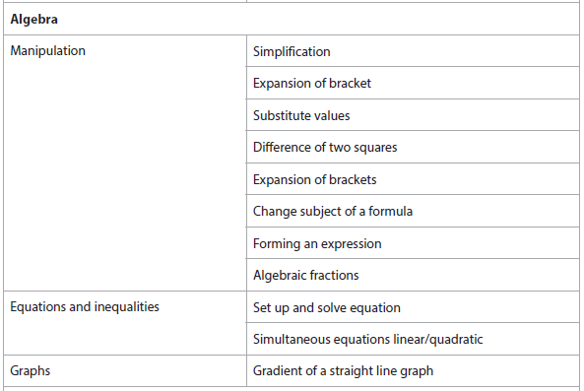
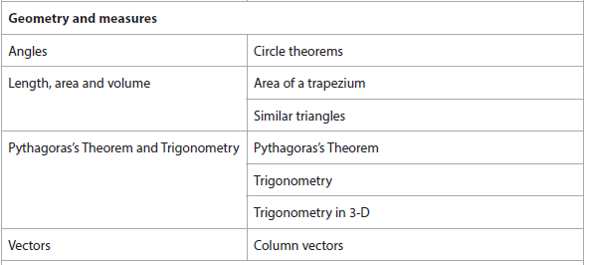
Advanced Information – 3H
Calculator

Slide 40
Section A: Number
This topic has been included in the previous revision booklet (paper 1) or in the first part of this booklet (paper 2).

Slide 41
Negative Number
$$Work out \\ 5−14$$ $$−5 −14$$ $$14 −(−5)$$ $$−14 −(−5)$$ | $$Work out \\ −2×−3$$ $$−4 ×−8$$ $${(−25)}^{2}$$ $${(−5)}^{3}$$
$$Work out$$ $$−125 ÷5$$ $$−96 ÷−4$$ | $$Work out$$ $$4x^{2}−2x+7 when x=−3$$
FOLLOW-UP WORK
Clips 38-44
https://www.mathsgenie.co.uk/gcse-may-june-2022-higher-topics.html
Negative Number

Slide 42
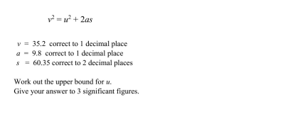
Bounds
$$Hint:Find the upper and lower bounds and \\ consider to what degree of accuracy they are \\ the same$$ | $$Hint: Rearrange formula to make u the subject$$
FOLLOW-UP WORK
Clips 137-139
https://www.mathsgenie.co.uk/gcse-may-june-2022-higher-topics.html
Bounds

Slide 43
Product Rule for Counting
FOLLOW-UP WORK
Clips 671-673
https://www.mathsgenie.co.uk/gcse-may-june-2022-higher-topics.html
Product Rule for Counting

Slide 44
Section B: Algebra
These topics have been included in the previous revision booklet (paper 1) or in the first part of this booklet (paper 2).

Slide 45
Substituting Values
 | $$Hint:Use the Quadratic Formula$$
FOLLOW-UP WORK
Clips 278-279; 780-789
https://www.mathsgenie.co.uk/gcse-may-june-2022-higher-topics.html
Substitution

Slide 46
Difference of Two Squares
$$Factorise x^{2}−25$$ $$Factorise 16−x^{2}$$ | $$Factorise x^{2}−y^{2}$$
$$Factorise 16x^{2}−25$$ | $$Factorise 12x^{2}−27$$ $$Factorise x^{3}−9x$$
FOLLOW-UP WORK
Clips 165; 224-225
https://www.mathsgenie.co.uk/gcse-may-june-2022-higher-topics.html
Expanding and Factorising Quadratics

Slide 47
Changing the Subject
$$Make a the subject of the formula:$$ $$y=aw+b$$ $$y=\frac{a+5}{c}$$ | $$Make a the subject of the formula:$$ $$y=b −2a$$
$$Make a the subject of the formula:$$ $$y=4a^{2}$$ $$y=\sqrt{a −4}$$ | $$Make a the subject of the formula:$$ $$x= \frac{4+2ab}{2a −3}$$
FOLLOW-UP WORK
Clips 280-287
https://www.mathsgenie.co.uk/gcse-may-june-2022-higher-topics.html
Changing the Subject of the Formula; Rearranging Harder Formulae

Slide 48
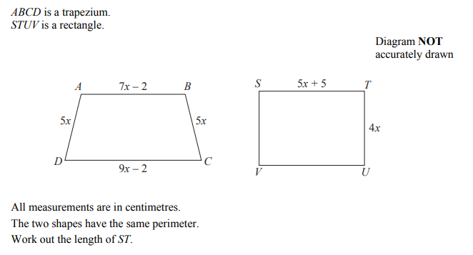
Forming an Expression/Equation
FOLLOW-UP WORK
Clips 151-153
https://www.mathsgenie.co.uk/gcse-may-june-2022-higher-topics.html
Forming and Solving Equations

Slide 49
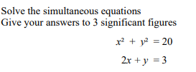
Simultaneous Equations
FOLLOW-UP WORK
Clips 190-195; 218-219; 246; 259
https://www.mathsgenie.co.uk/gcse-may-june-2022-higher-topics.html
Quadratic Simultaneous Equations

Slide 50
Gradient
FOLLOW-UP WORK
Clips 201-204; 207, 210
https://www.mathsgenie.co.uk/gcse-may-june-2022-higher-topics.html
Gradient of a Line

Slide 51
Section C: Ratio, Proportion and Rates of Change
These topics have been included in the previous revision booklet (paper 1) or in the first part of this booklet (paper 2).

Slide 52
Time and Speed
$$Convert the following:$$ $$4 hours and 24 minutes into a decimal$$ $$\dot{3}hours into hours and minutes$$
FOLLOW-UP WORK
Clips 709-711; 716-724
https://www.mathsgenie.co.uk/gcse-may-june-2022-higher-topics.html
Speed

Slide 53
Reverse Percentage
FOLLOW-UP WORK
Clip 96
https://www.mathsgenie.co.uk/gcse-may-june-2022-higher-topics.html
Reverse Percentages

Slide 54
General Iterative Processes
FOLLOW-UP WORK
Clips 322
https://www.mathsgenie.co.uk/gcse-may-june-2022-higher-topics.html
Iteration

Slide 55
Section D: Geometry & Measure
These topics have been included in the previous revision booklet (paper 1) or in the first part of this booklet (paper 2).

Slide 56
Area of a Trapezium
$$Find the area of the trapezium$$
 | $$Find the area of the trapezium$$
FOLLOW-UP WORK
Clip 559
https://www.mathsgenie.co.uk/gcse-may-june-2022-higher-topics.html
Area and Perimeter

Slide 57
Similar Triangles
FOLLOW-UP WORK
Clips 611-613
https://www.mathsgenie.co.uk/gcse-may-june-2022-higher-topics.html
Similar Shapes (Lengths)

Slide 58
Trigonometry
FOLLOW-UP WORK
Clips 508-515
https://www.mathsgenie.co.uk/gcse-may-june-2022-higher-topics.html
SOHCAHTOA (Trigonometry)

Slide 59
Trigonometry in 3D
FOLLOW-UP WORK
Clips 854-863
https://www.mathsgenie.co.uk/gcse-may-june-2022-higher-topics.html
3D Pythagoras and Trigonometry

Slide 60
Column Vectors
$$Starting from P, \\ draw the vector \begin{matrix}6 \\ −1\end{matrix}$$
FOLLOW-UP WORK
Clips 623-657
https://www.mathsgenie.co.uk/gcse-may-june-2022-higher-topics.html
Vectors

Slide 61
Section E: Probability

Slide 62
Dependent Combined Events
FOLLOW-UP WORK
Clips 364-367
https://www.mathsgenie.co.uk/gcse-may-june-2022-higher-topics.html
Conditional Probability; Probability Equations

Slide 63
Section F: Statistics

Slide 64
Frequency Polygons
FOLLOW-UP WORK
Clip 441
https://www.mathsgenie.co.uk/gcse-may-june-2022-higher-topics.html
Frequency Polygons

Slide 65
Histograms
FOLLOW-UP WORK
Clips 422-449
https://www.mathsgenie.co.uk/gcse-may-june-2022-higher-topics.html
Histograms

