Slide 1
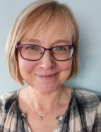
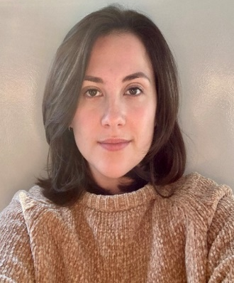
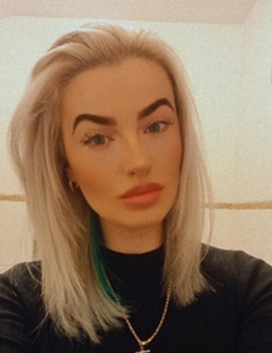
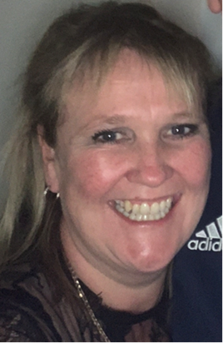
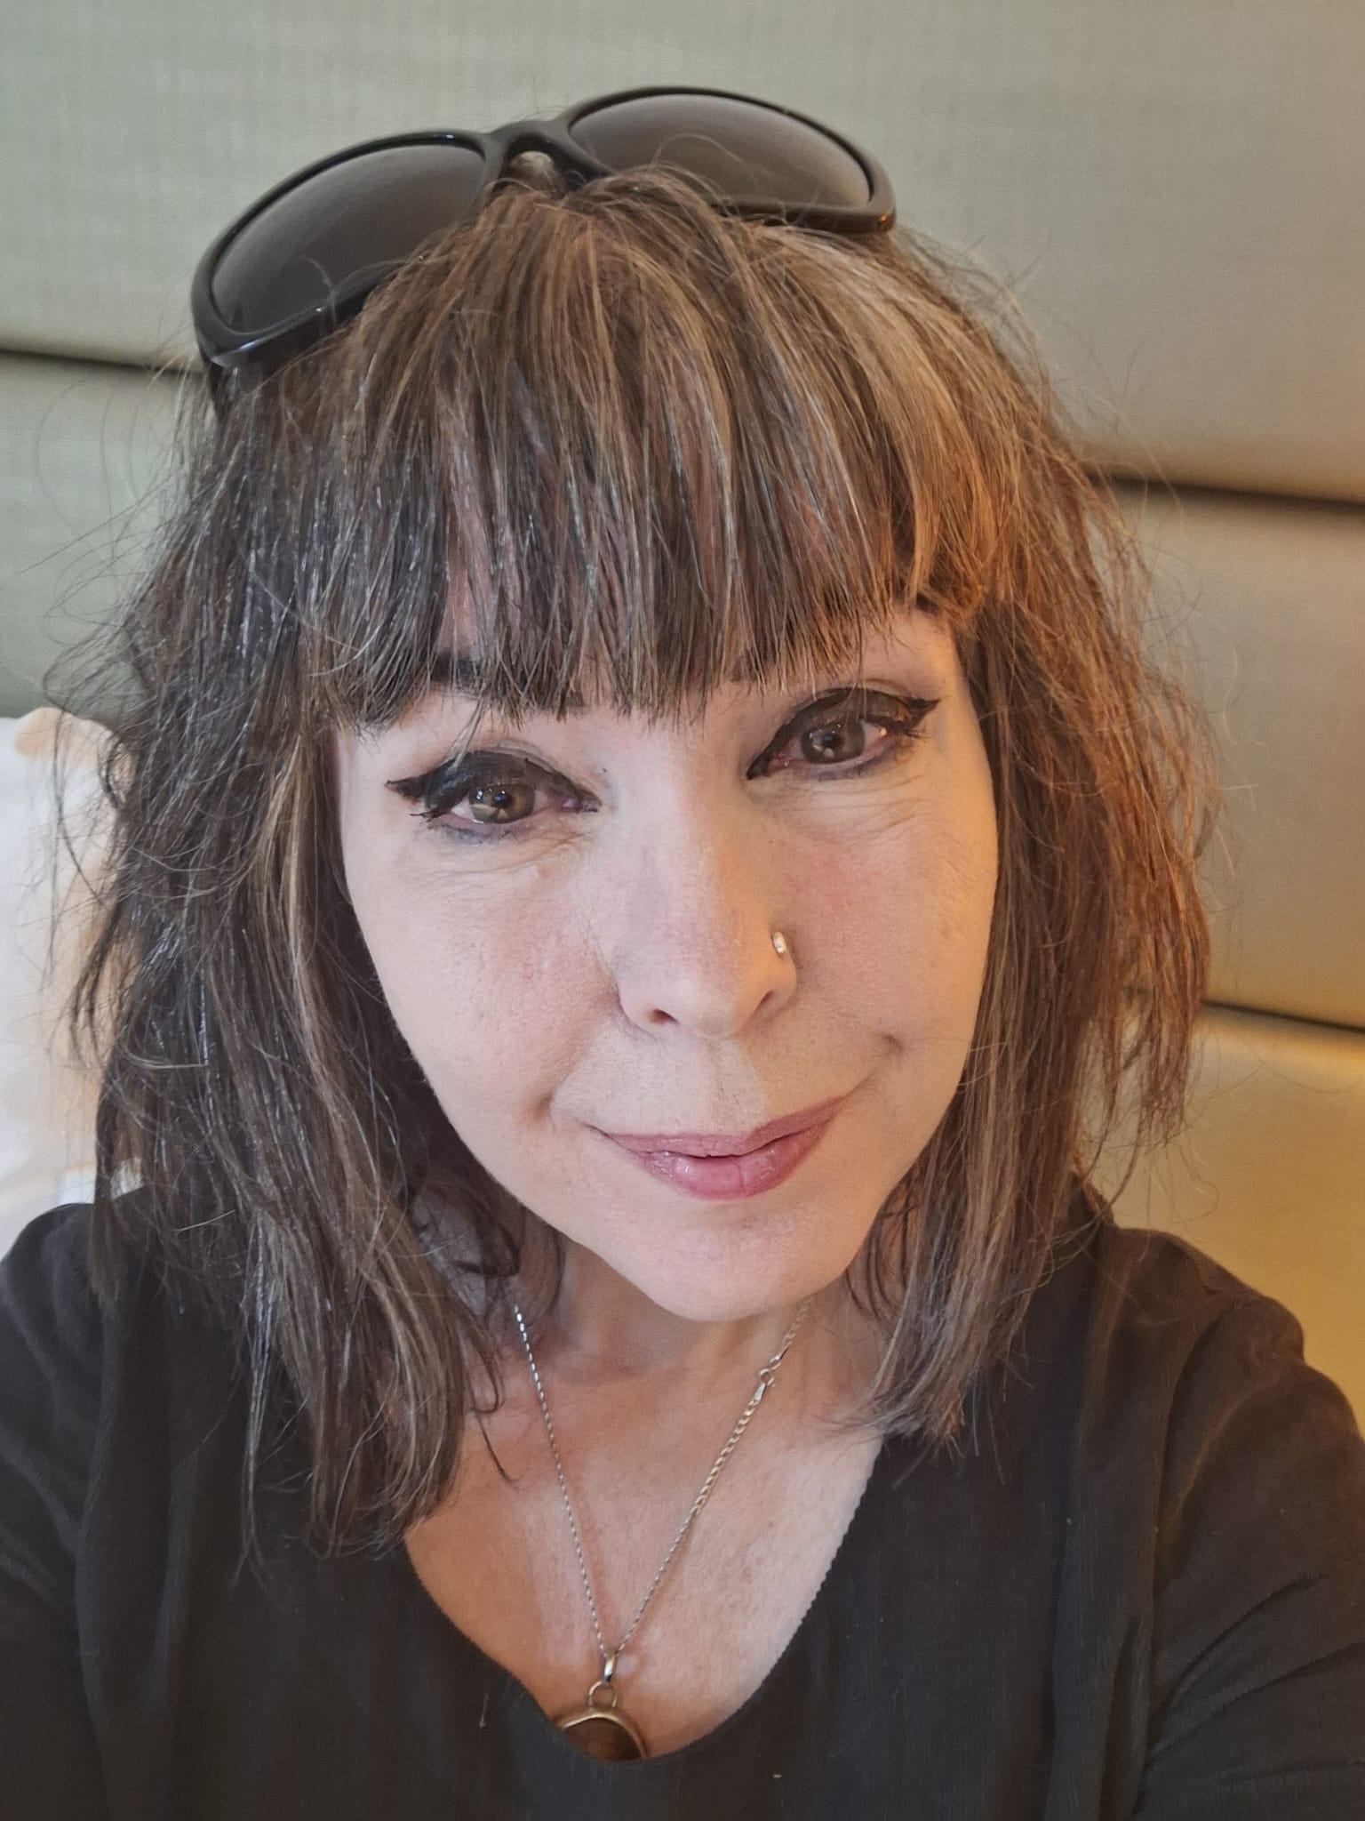
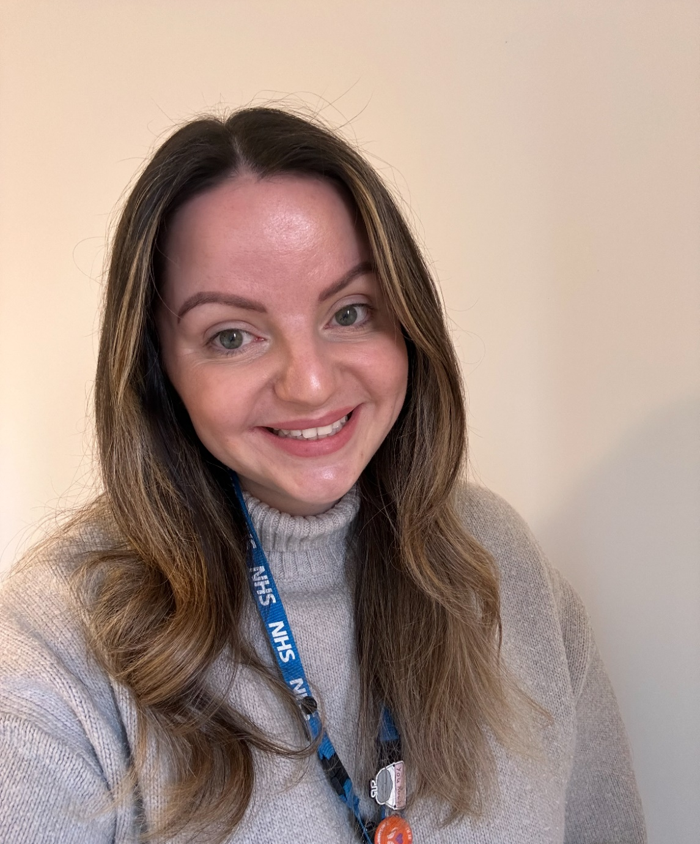
Meet the Corby Mental Health Support Team (MHST)
Jo
Johnson
Jaymee
Stanley
Chelsea
Towns
Kim
Esslemont
Carrie
Sanders
Abi
Mckim-Hay

