Slide 1
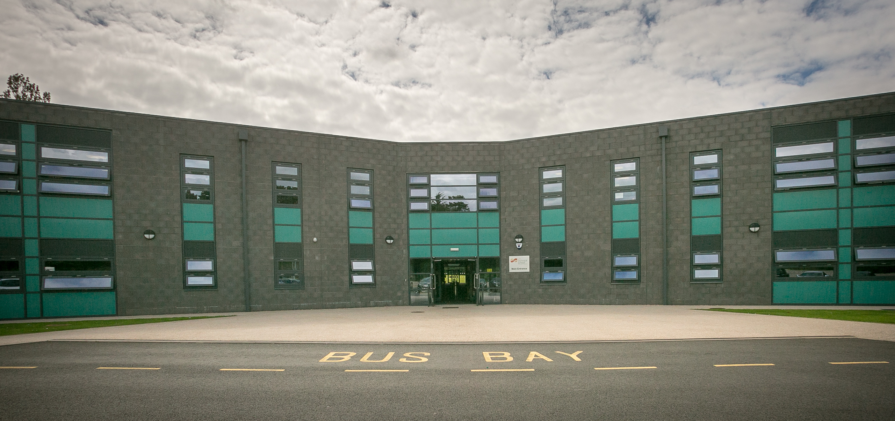
Welcome
to Corby Technical School Virtual Transition Week
You will find activities in this PowerPoint for you to complete at home on each day of the week. This will help you to prepare for life at Corby Technical School, and will help us to get to know you.
Please see FAQs about transition at the end of this presentation

Slide 2
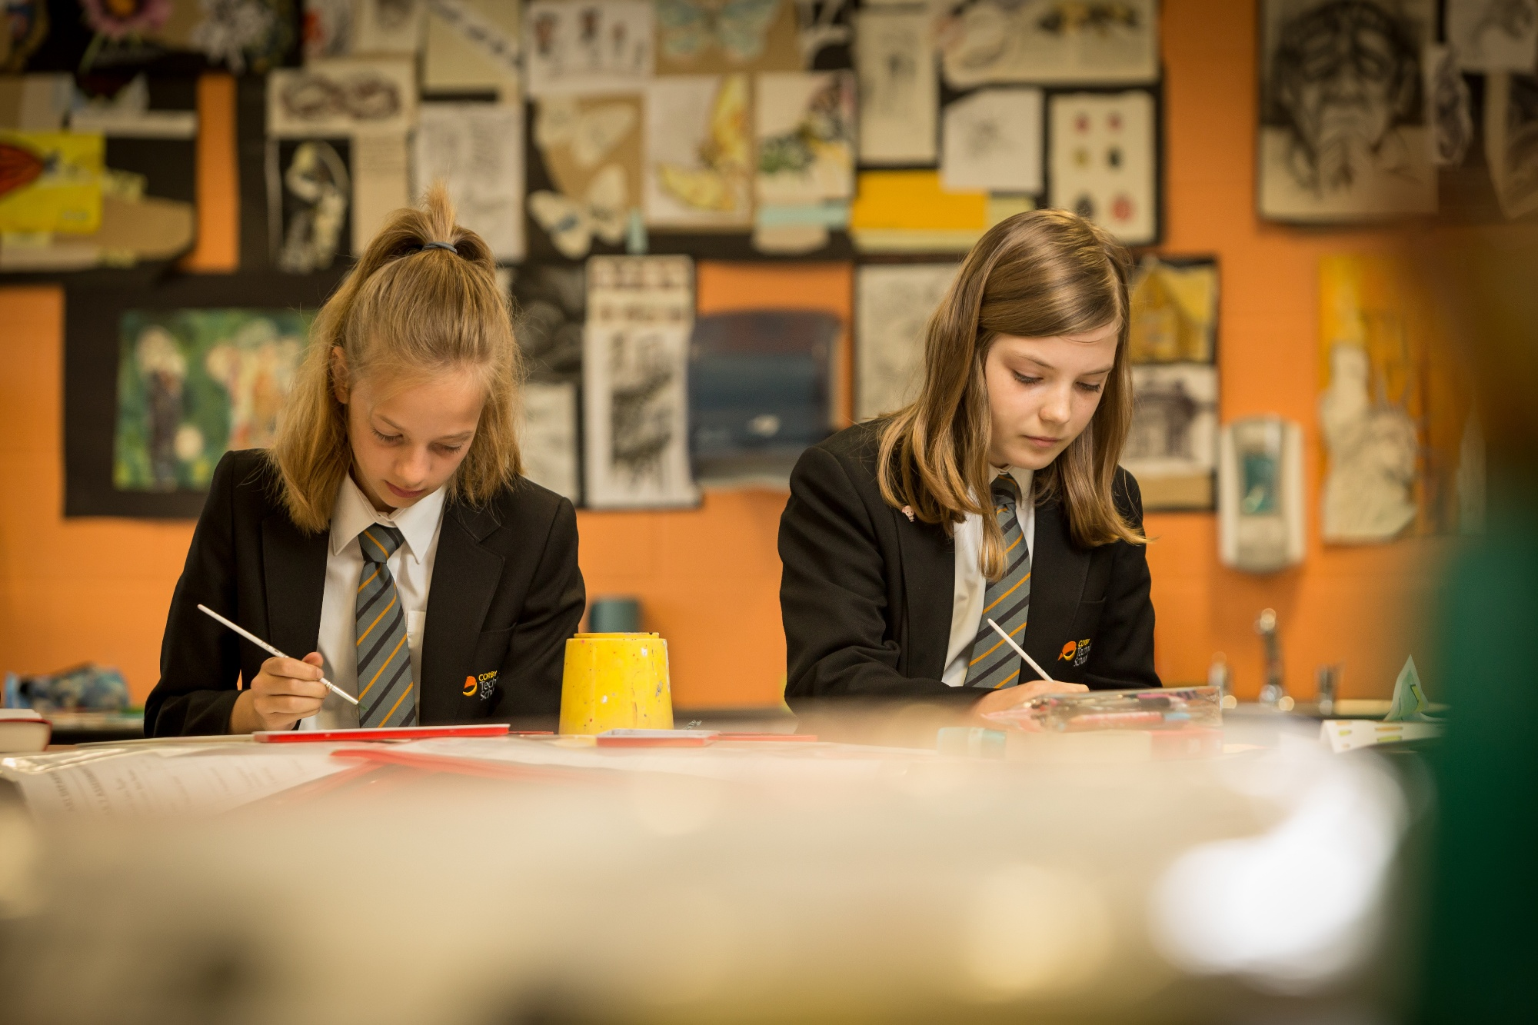
Just for fun
Activity Guide
These activities are to help you to prepare for your time at CTS, there is no need to return these or bring them in
Instructions for all activities are in an orange box like this
Online Activity
Complete these activities online using Microsoft Teams by clicking on the link
If you have a printer and would like to print the resources, please find PDF versions on our website by clicking here.
Alternatively, you can complete any activity on your own paper.
Share your work
If you would like to bring these to school when you start, then you will have a chance to share this work

Slide 3

Monday

Slide 4

Letters from years 7&8
Dear Year 6
We hope you are looking forward to coming to Corby Technical School .
This time last year I was a student at Beanfield Primary School . I was worried about making new friends at secondary school . When I got to CTS in September I made friends in my tutor group, the teachers were nice . My favourite lessons were RSCS, PE and Art when I started but now I like History and Geography.
If I needed any help I went to see my form tutor, but you can talk to any of the teachers.
We are looking forward to seeing you soon ,
Bianca, 7TE
Dear Year 6,
We hope you are looking forward to coming to Corby Technical
School.
On the next couple of slides you will see that some of our current students in years 7 and 8 have written you letters telling you how they felt when they joined CTS. We hope that you enjoy reading them.
We are looking forward to seeing you soon
From Miss Buffini

Slide 5
Dear Year 6
We hope you are looking forward to coming to Corby Technical School .
This time last year I was a student at Studfall Primary School . I was worried about not knowing where I was going when I got here. When I got to CTS in September I really liked it, I knew a lot of people from my football team. My favourite lesson was definitely PE , I still like PE best but Art is ok. The food is really good here especially the sausage rolls. If I needed any help, if I got lost I asked anyone who works at the school. We are looking forward to seeing you soon ,
Nicco, 7ST
Dear Year 6
We hope you are looking forward to coming to Corby Technical School.
I went to Saint Patrick’s Primary School and have been here a year. When I got to CTS in September, I really liked it, especially the people. The building is cool there is plenty of room. I really like the restaurant, Friday is great because you can have chips but the fish finger baguette is good too. Now I have been here a bit I feel really comfortable and safe, the teachers are good. If I needed any help, I talk to my tutor or my Head of Year. We are looking forward to seeing you soon,
Jacson, 8SW

Slide 6


CTS Quiz
Online Activity
Test yourself on what you already know about CTS and some of the subjects you will be learning about.
Click on the form in the link below to answer the questions and click on ‘view results’ to see how many questions you got right.
Click here for quiz

Slide 7

Just for fun
When you go to secondary school, you will learn a huge number of new skills, and improve skills you have practiced in Primary School. In the goal below, write in 6 new skills or things you’d like to build on in your years at secondary school. Use the grid for ideas but feel free to include your own!
Be in a school play or production | Speak another language
Learn to play a musical instrument | Represent your school in a competition
Play for a school team | Learn how to survive in the wild
Learn how to manage money | Taste food from another country
Cook a new meal from scratch | Read new books
Create a piece of art | Raise money for charity
Learn how to read a map | Join an after school club
Use computers to create your own website | Improve your singing
Learn to play a new game (like chess) | Work as part of a team

Slide 8

Tuesday

Slide 9


Online Activity
Virtual Postcard
Complete an online postcard to Corby Technical School. This will give us a chance to find out a little more about you.
Click here for the link to the postcard

Slide 10
Just for fun
Expectations apply to the way we choose to conduct ourselves, the way that we behave towards other people, and the way that we behave in our lessons.
They are expectations, because we are expected to behave in this way; it is not a choice.
The expectation that we have is that we all behave in a way that means that we are calm, collected and respectful towards one another, and that we arrive for our lessons punctually and well prepared.
Have a look at the list below and identify any of the expectations that might not come naturally to you. Set these as ‘new school year resolutions’ for when you join CTS
Keeping good attendance over the whole year
Having your shirt tucked in neatly
Contributing to lessons when asked
Listening carefully when someone is speaking to you
Being respectful of other peoples beliefs
Saying good morning to people as you pass
Supporting others
Maintaining focus in your lessons
Arriving at school on time
Holding the door open for one another
Having the right equipment
Going above and beyond with your work
Tidying up after yourself in the restaurant
Turning up on time to lessons
Challenging yourself to do new things
Staying calm if something goes wrong
Being thoughtful about other people’s feelings
Discussing issues with a teacher when you need support
Sitting with someone who is alone at lunch
Being respectful to other staff and students
Apologising if you have done something hurtful
Sticking with it and staying positive even when you are finding your work tough
Smiling at others when moving through the school
Asking for help when needed
Remembering your homework
Giving someone a compliment

Slide 11

Wednesday

Slide 12

Year 7 English
In year 7, we develop our reading and writing skills by becoming much more analytical with our writing. We start to question why rather than just what or how when we read.
We have 1 literacy/library lesson a week where we work on developing our literacy skills and our vocabulary. We spend half of the session in the library using a programme called Accelerated Reader and private reading.
In term 1, you will get to a read a wonderfully creepy and suspense-filled book called, “The Bad Beginning,” and we learn all about heroes and villains.
We would love to hear what you have been reading over the summer by completing our book review on the next slide! Bring this to your first English lesson in September to share with your teacher.

Slide 13
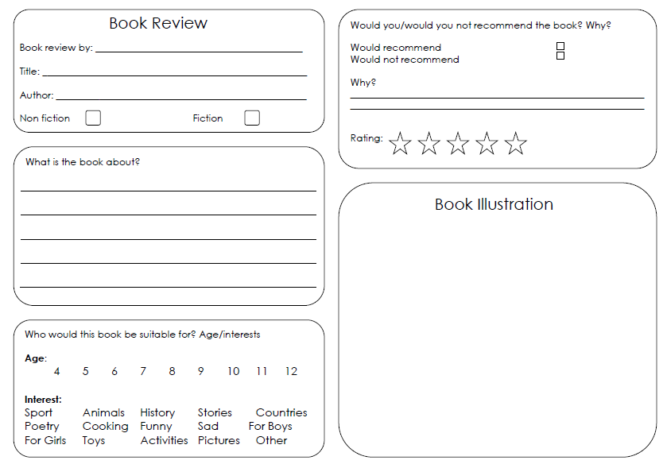
Book Review
Complete a book review to bring with you to your first English lesson
Draw a picture that you think sums up the book in one image
Share your work

Slide 14


Book Bingo
Share your work
Circle any boxes you have completed and bring back to the library on the first day. There will be a prize for any winning grids returned to the library…
…be prepared to explain in more detail about how you did each one if asked!
Top tip – if you don’t have a printer, just write a list of the ones you have done to bring in instead.

Slide 15

Thursday

Slide 16
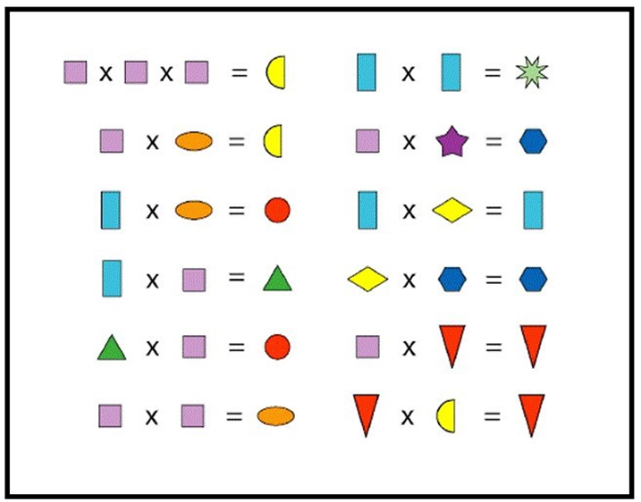
Maths Activities
Just for fun
The coloured shapes stand for eleven of the numbers from 0 to 12. Each shape is a different number. Work out which is which. *HINT* Think about what would be.

Slide 17
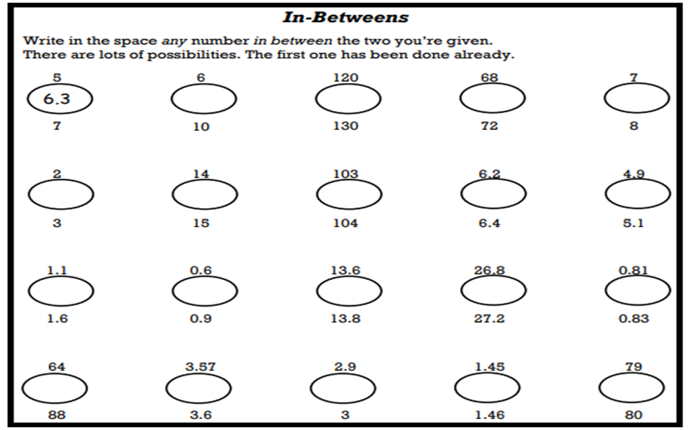
Maths Activities
Just for fun
In Between Numbers - Write in the circle any number in between the two you’re given. There are lots of possibilities. The first one has been done already

Slide 18
Managing Challenges
Just for fun
Read the challenge and see if you can work out a way of managing this challenge now and in the future. Click on the box to see our suggestion – was yours the same?
Challenge | How could you manage this challenge now? | How could you manage this challenge in the future?
Getting lost around the new school | You could look on the school website for maps, pictures or videos of what the school is like. | You could ask other pupils and teachers for help if you get lost — everyone will understand that you are still finding your way around and that this might take time!
Not being in the same class as friends | You could try to focus on the positives. Secondary school is a great opportunity to make new friends. | You will make new friends when you get to your new school. Everyone will be in the same position — they will all be new too!
More homework | You could find out about homework on the school website and see if there is a homework club where you could work every day too, if you need a quiet space. | You could create a homework timetable to help plan what homework to do when — not all subjects will set homework every day.

Slide 19
Managing Challenges
Just for fun
Here’s a few more challenges for you to work out – click on the boxes to see our solutions
Challenge | How could you manage this challenge now? | How could you manage this challenge in the future?
Big restaurant and choosing a meal | You could look on the school website for menu examples, or pictures of how the lunch hall is set up. | You could ask to meet some people from your class at lunch so you can all eat together.
Don’t understand new subjects | You could read about different subjects on the school website if you would like to find out more information about what topics you will study. | You will always be able to ask teachers for help whenever it is needed!
Not knowing the rules and getting a detention | There will be information and welcome videos on the school website to watch to find out about what a normal school day might be like. | Expectations will be explained in the first few weeks of starting secondary school. If you are unsure of any rules, teachers and older students can be asked.

Slide 20

Friday

Slide 21



Celebrating your success
Just for fun
My Journey So Far:
Think about the last few years of school…
Try to come up with at least one example of:
Something you are proud of
Progress you have made (skills, subjects, friendships etc.)
The best thing you have learnt
Ways in which you have changed between Reception and now
A routine or habit you would like to keep when in secondary school

Slide 22

Message to self
Just for fun
Which key pieces of advice are going to help you manage your thoughts and feelings so that you are fully prepared for all the opportunities and challenges of moving into Year 7?
Write a short uplifting message of advice to yourself. This can be opened and read on the evening before you start your new school.

Slide 23

Online Activity
Summer Reading
We know that as you start secondary school you’ll be hoping for many things, and we know there are many possibilities that will open up to you. You have the power to change the world and reading The Book of Hopes is the perfect way to start.
You can read it for free online at:
https://issuu.com/bloomsburypublishing/docs/thebookofhopes_interactivepdf/376
(Please note, this only works fully with Google Chrome internet browser)
You don’t have to read all of the book at once, but over the Summer Holiday we would encourage you to dip in and out of it, choosing stories, poems and essays that appeal to you.

Slide 24
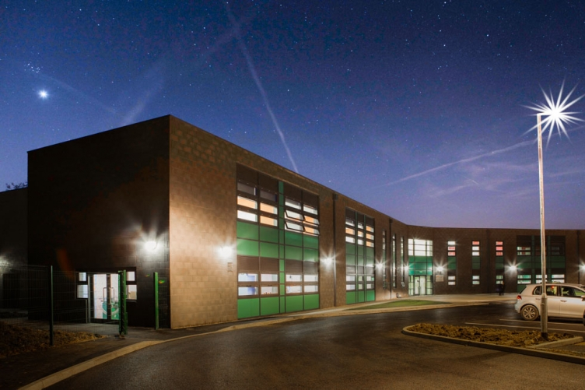
FAQs
On the next couple of pages you will find some questions that were asked by students in our last questionnaire. Click on the question to reveal the answer!

Slide 25
FAQs
What if I have a food allergy or intolerance?
The restaurant caters for dietary requirements including lactose/gluten free. Nuts are never served and all allergens are clearly marked on the menus.
When will I find out my tutor group and who my tutor is?
We are in the process of organising this at the moment. We will update our website with information on tutor groups and Form Tutors in the coming weeks.
Can I buy 2nd hand uniform or do I need to buy new?
The logo has changed on the blazers however the old ones are still acceptable to wear in school. Uniform can be purchased from KS Schoolwear and the uniform pages on our website include a handy guide for measurements should you wish to order online.

Slide 26
FAQs
What time and date does school start?
The term is due to start on Thursday 3rd September. Please keep an eye on our website as timings for the school day are under review and school opening is subject to government guidance due to Covid-19.
When do we put money on our swipe cards?
Your parents will be able to load your account with credit before the first day, then when you receive your card it will automatically be updated with your balance.
How will I know my way around?
When you first get to school you will be met by members of staff to guide you to where you need to go. You will be given a map of the school and you can ask at any time if you are lost. There are lots of friendly people about.

Slide 27
Thank you and well done!
We are looking forward to meeting you in person. Have a lovely Summer break

