Slide 1
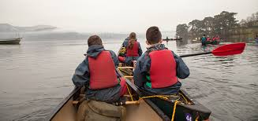
Year 10 residential 30th May - 3rd June 2022 Howtown, Lake District

Slide 2
Our mission is to inspire young people to defy their limitations so they become strong, resilient and curious, ready for the challenges of life.
Learning about yourself happens best out in the wild. We take young people away from the everyday life into our world, to give them life-changing experiences they won’t get from home or inside the classroom.
Notes:
The Outward Bound Trust is a charity working with school age children and young people.
Ethos
They have five centres across the country - we have chosen to go to Howtown as it allows for both watersports and mountain experience in the programme

Slide 3
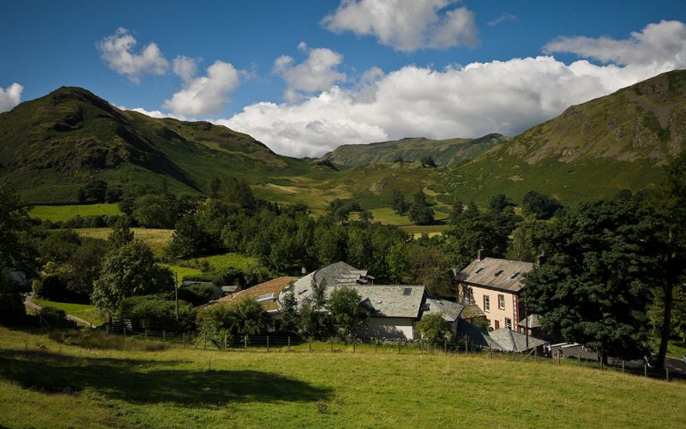
Notes:
This is the centre - it looks beautiful but remember that the sun may not be shining all the time, although at the end of May we would hope to have some fine weather

Slide 4
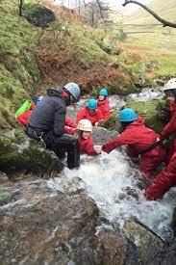
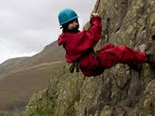
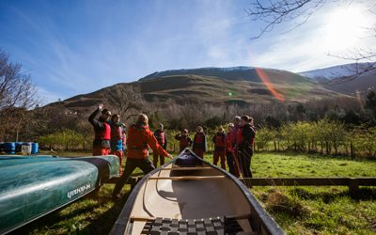
Notes:
While at Howtown you will have the chance to experience a range of outdoor activities which will develop your personal qualities of
Confidence
Emotional wellbeing
Improved relationships
Resilience
Confidence in learning
Understanding of the natural environment

Slide 5
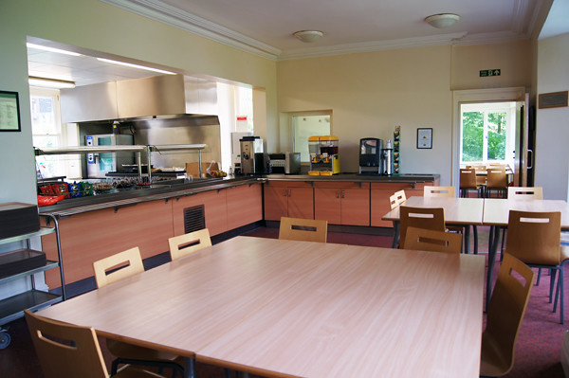
Notes:
This is the accommodation block at the centre
Rooms are typically 4 - 6 room dormitories with an ensuite bathroom and we will make sure that students are put in friendship groups
All meals are provided by the centre, you will have the option of a cooked or continental breakfast, lunch is usually a packed lunch as you will be out and about during the day, we then return to the centre for a hot evening meal, dietary requirements are catered for, so long as you let us know what they are

Slide 6
Notes:
This is a typical programme for a five day course.
I expect we will leave CTS early - probably around 7am, and travel by coach to the Lake District

Slide 10
Notes:
Travel back to CTS by coach, arriving back around 7.30pm

Slide 11
Key information
Dates Monday 30th May - Friday 3rd June
**Note Thursday and Friday are bank holidays**
36 places available
Cost £410
Deposit £110 payable by Friday 25th February
3 monthly payments of £100
All payments to be made via Wisepay
Kit lists will be provided
Notes:
Final pieces of information are dates - please note that the Thursday and Friday are both bank holidays for the Queens Jubliee, please do check your family calendars before booking
We have 36 places available - I do expect to operate a waiting list
The cost is £410 which includes all transport, food and adventure equipment
We need a deposit of £110 NON REFUNDABLE payable by next Friday followed by three monthly payments of £100, if the cost is a barrier to you applying for the residential please contact the school to discuss what we can do to help
All payments are to be made on Wisepay

Slide 12
Notes:
If you have any questions, ask your for tutor first, ask me

